Slide 1
An insight into Trading Standards in relation to Safeguarding Lee Ormandy, Surrey Trading Standards

Slide 2
Role of Trading Standards

Slide 3
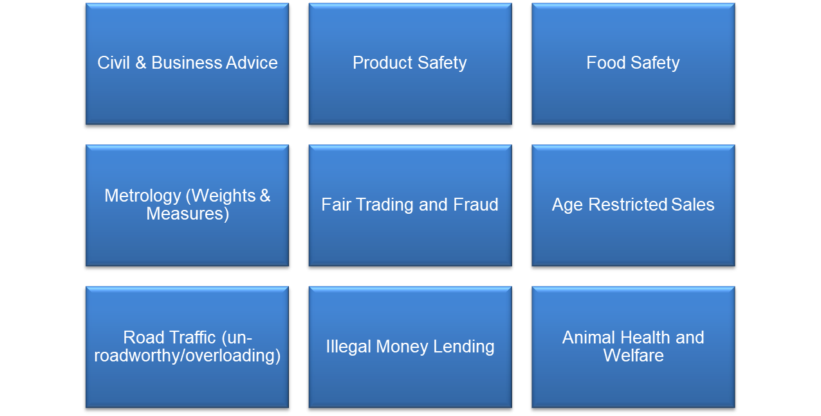
Main Functions

Slide 4
Safeguarding
Scams and fraud are financial abuse.
Postal, telephone, email and doorstep scams are often targeted specifically at disadvantaged residents or those in periods of vulnerability. Such fraud costs the legitimate economy between £5 and £10 Billion a year.
Fraud can have a devastating impact on these victims and increase the disadvantage, vulnerability and inequality they suffer. Fraud can also cause lasting mental and physical trauma for victims and results in lost opportunities for individuals and businesses.
Being a scam victim is associated with significantly lower levels of life satisfaction, lower levels of happiness, and higher levels of anxiety.
If the victim had formed a meaningful relationship with the scammer, then betrayal trauma, anxiety and depression, guilt, embarrassment, anger, stress, and sometimes substance abuse can follow. Those with a previous history of mental illness could face a relapse or worsening of their condition.
An older victim of doorstep crime is 2.4 times more likely to go into residential care or die within 2 years

Slide 5
TS Prevention Team
In 2020 Trading Standards set up the TS Prevention Team, a specialist unit which provides assistance and support to vulnerable residents who have been, or are susceptible to, being targeted by criminals eg fraud, scams and other malevolent trading practices.
Since inception this small team of five officers has made interventions with over 1,700 residents, generated savings in excess of £37million and prevented over 140,000 scams.
In 2022/23 Trading Standards made 642 interventions to individuals with vulnerable characteristics, 15 of which were direct referrals from ASC. The total amount of money saved during these interventions was £1,107,203.
Trading Standards responded to 19 doorstep crime incidents which prevented losses of £183,445.
110 call blocker devices were installed (taking the total to 547) together with 31 door cameras. These devices blocked 48,165 scam and nuisance calls and prevented losses of £1,824,971.
The total financial impact for 2022/23 interventions (taking into account Health and Social Care costs and avoidance of residential care) is £11,087,193.

Slide 6
Safeguarding
Trading standards and partner agencies investigate scams and identify and support those who fall victim fraud and scams.
Our aims are:
To IDENTIFY our most at risk residents and provide targeted holistic support.
To INTERVENE and protect victims from further victimisation.
To INVESTIGATE criminal activity.
To REDUCE the opportunities for scammers by empowering residents and communities.
To INCREASE engagement with marginalised groups including those impacted by international conflict, instability and poverty
To INFLUENCE people to TAKE A STAND AGAINST SCAMS AND FRAUD.

Slide 7
Resources

Slide 8
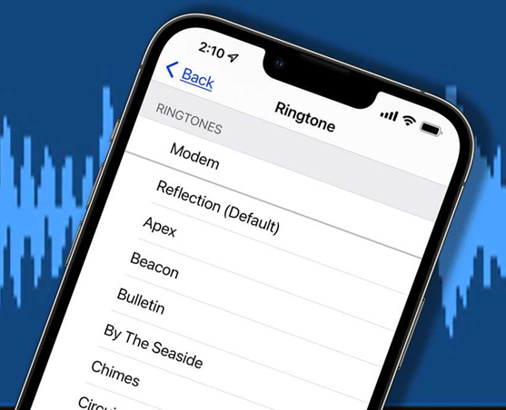
Technology

Slide 9
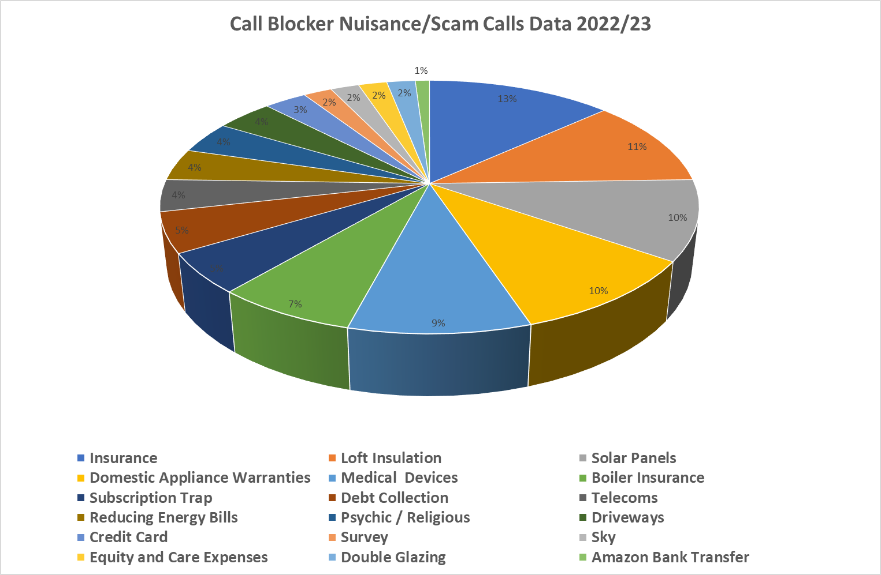

Slide 10
Feedback
“The Truecall device has made such a difference to my elderly mother (98) and my disabled sister (70) as they can now answer the phone with confidence. As their carer I have peace of mind knowing that nobody can get through who they don't know. They were victims of a scam and the phone is now one thing I do not have to worry about. Thank you”
“Thank you for doing such a good job and providing valuable information.”
“It’s the only time I get to hear another human voice.”
“Extremely grateful and were not expecting that level of service.”
“I am grateful you are checking on my mum, thank you.”
“I have contacted my banks and they are returning £25,000 I thought I had lost forever, I couldn’t have done it without you.”
“My husband & I are much happier now that we have the Truecall device. We don't feel threatened now when we answer the phone.”
“I no longer am worried when the phone rings since the device has been installed..”
“The device has eliminated nuisance calls completely. I feel much safer having it.”
“This Truecall device is one of the best pieces of equipment we have ever had. We are most grateful for this device and it has solved the problem with nuisance callers - virtually overnight!”

Slide 11
SERIOUS AND ORGANISED CRIME PARTNERSHIP BOARD Chair: Lee Ormandy, Surrey Trading Standards Deputy Chair: DCS John Boshier, Surrey Police

Slide 12
Background
Serious and organised crime is rarely local; it crosses geographical and regulatory borders and is constantly changing. Tackling these crimes require a coordinated multi-agency approach not only in terms of investigating offending, but also in protecting our communities and supporting those that have been a victim of fraud to prevent repeat victimisation and build community resilience.
Due to its significant financial and psychological effect on victims, it can impact on a number of local public, private and voluntary sector organisations all with a role to play in tackling it. This is why a multi-agency approach which pools data, knowledge and resources can create greater consistency and ultimately better outcomes for both enforcement and prevention.

Slide 13
Introduction
The NCA National Control Strategy 2023 provides a framework to guide the UKs collective operational response to serious and organised crime with the NCA National Strategic Assessment identifying four trends which are driving an overall increase in the SOC threat
Criminals exploit vulnerabilities created by the enduring impacts of international conflict, instability and poverty
Criminals exploit the cost of living increase, taking advantage of peoples vulnerability
Advances in technology make it easier for criminals to exploit free and commercial tools along with criminally dedicated platforms.
Criminals have demonstrated resilience and adopted in response to the challenging operational environment and successful law enforcement operations

Slide 14
Objectives
To maintain and develop a multi-agency integrated framework that corrals intelligence, preventative and protective activity, expertise and investigative resource in combating identified local threats and provides victims with a cohesive needs-based service
To better inform strategic and operational decision making by encouraging the more effective and timely sharing of data between participating agencies.
To reduce duplication of “protect” and “prevent” messaging ensuring that participating agencies are joined up in any local educational initiative that is focused on increasing public awareness of a local threat – one voice.
To improve the quality of victim care available to victims by establishing a holistic multi-agency situational driven support service that listens to victims and works with them to address their immediate and longer term “protect” and “prevent” needs.
To ensure that members of the Board, including agencies/charities providing victim services, receive the necessary training and the appropriate tools and practical support to enable them to perform their duties to the requisite standards. This includes members promoting and sharing learning and best practice in relation to tackling SOC threats.

Slide 15
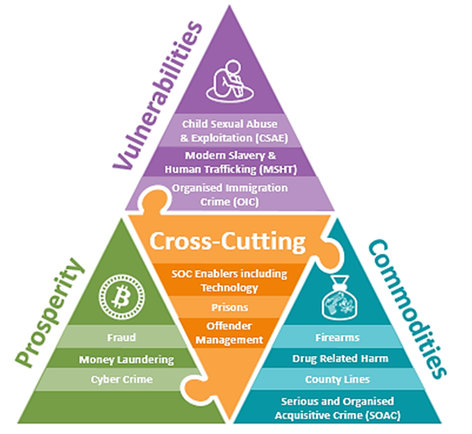
Key Areas of Focus
Vulnerabilities:
Child Sexual Abuse & Exploitation, Modern Slavery & Human Trafficking,
Organised Immigration Crime, Youth Violence
Prosperity:
Fraud, Money Laundering, Cyber Crime
Commodities:
Criminal use of Firearms in SOC, Drug Related Harm,
County Lines, Serious and Organised Acquisitive Crime
Cross Cutting Themes:
Anti-corruption, SOC Enablers, Prisons Offender Management

Slide 16
Strategic Priorities
The SOC Partnership Board determines its priorities annually. These are taken from the Surrey Force Control Strategy, a strategic assessment process analyses contributions from a diverse range of agencies. Our current priorities continue to be:
Drug Related Harm and County Lines
Economic Crime including Fraud and Cyber Crime
Serious and Organised Acquisitive Crime
Modern Slavery and Human Trafficking
Which align with the priority threat areas identified by the NCA in the National Control Strategy 2023:-
Dominate Communities
Exploit the Vulnerable
Undermining the UK Economy

Slide 17
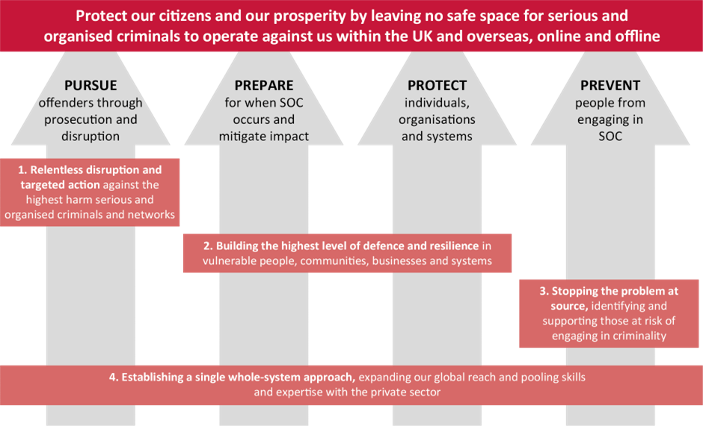
Four P Delivery Plans
In line with the NCA National Control Strategy the SOC Partnership Board uses the four ‘P’ Delivery Framework of Pursue, Prevent, Protect and Prepare.
The Four P plans produced by the portfolio holders, SOC JAGs and partners, provide:
strategic oversight
Inform KPIs
ID Emerging Trends
Share Best Practice
Celebrate Success

Slide 18
Clear, Hold, Build
The core aim is to:
Reclaim and rebuild communities persistently affected by organised criminal groups
Restore the relationship between residents, the police and statutory agencies
Clear, hold, build is an operational framework designed to improve the local response to tackling one or a combination of serious and organised crime threats. It involves partners and the community working together in a cohesive way to deliver sustainable reductions in serious organised crime by moving beyond conventional enforcement tactics.
Clear: interventions and disruptions that target organised crime group members, their networks, business interests, criminality, spheres of influence and impede their ability to operate. This creates safer spaces to begin restoring community confidence.
Hold: interventions, counter-measures and contingency plans to consolidate and stabilise the initial clear phase. This prevents remaining or other organised crime group members from capitalising on the vacuum created. It improves community confidence by ensuring spaces remain safe.
Build: a single, whole-system approach to delivering community-empowered interventions that tackle drivers of crime, exploitation of vulnerabilities and geographic places where crime occurs. This improves living, working and recreational environment in the community for residents. It empowers them to work with stakeholders to generate resilience and build a safer community.

Slide 19
Partnerships
Challenges
2 million residents
1/5 population over 65
20,000 residents living with dementia
Fear, Intimidation, Embarrassment, Ignorance, Confusion
Language
Cultural Sensitivities/barriers
Isolation/Marginalisation
Low levels of reporting
Opportunities
Access to knowledge, skills, experience and contacts
Wider and more diverse reach
Share expertise and investigative resource
Avoid duplication
Coordinate preventative and protective activity
Provide victims with a cohesive needs-based service
Improve outcomes

Slide 20
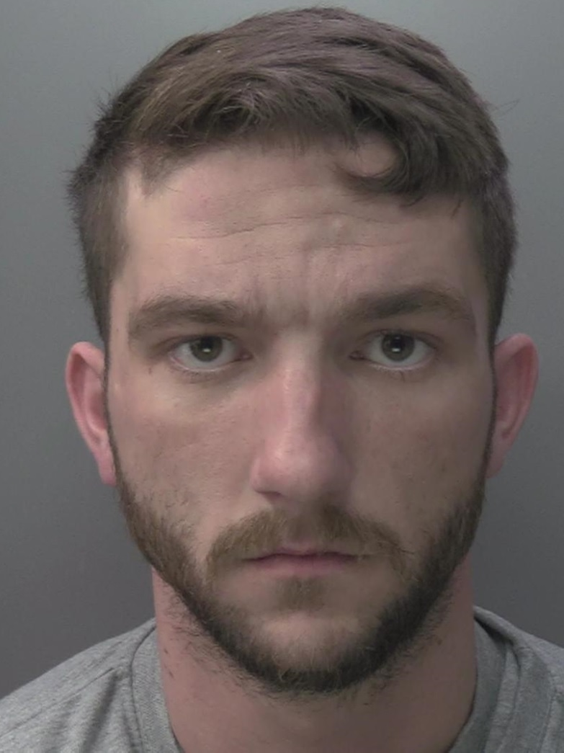
Hughie Smith John Smith
Doorstep Crime - victim coerced into paying £5,500 to paint the render on their home. The work was valued at £850.
Another victim quoted £2,100 paid £200,000
Another victim quoted £2,100 paid £180,000
Another victim quoted £2,100 paid £198,000
Victims across Surrey, Sussex, Kent and Brighton and Hove.
Targeted, groomed and intimidated elderly vulnerable residents. Became aggressive and took victims to the bank to withdraw money
“This used up our pension fund. We were trying to get the house in order because Guy was terminally ill before he passed away.
“This happening broke our hearts. It was sad that we had to deal with this in the months before his passing.”
Hughie Smith 8 year custodial
John Smith 14 month custodial
Michael Smith 14 month suspended

Slide 21
Social Media

Slide 22
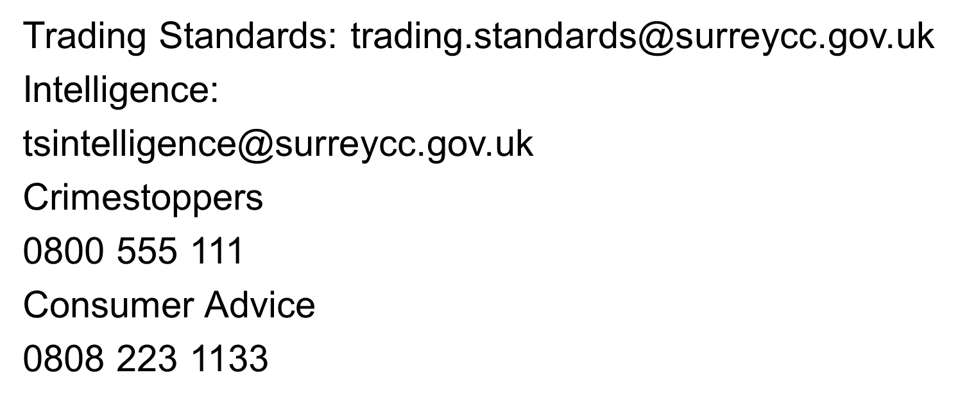
Contact

Slide 23
Thank you

