Slide 1

Introduction to Domestic Abuse
Trainer: Bridie Anderson
Date: 25.11.24
Created by Bridie on behalf of ESDAS 2023

Slide 2

The content of this course is emotive & challenging please look after yourselves by taking time-out & seeking appropriate support
Notes:
Trainer Notes:
Important reminder to all learners how impactive and upsetting content may be, due top personal or professional experiences. Look after themselves and ‘private message’ trainer if they want to discuss anything or take a step out of the training.

Slide 3
Aim
To introduce the key typologies of domestic abuse, the dynamics of abuse as experienced by victim-survivors, perpetrator tactics and the range of support pathways and resources available in Surrey for professionals and victim-survivors.

Slide 4
What is Domestic Abuse
‘Abusive behaviour’ is defined in the act as any of the following:
physical or sexual abuse
violent or threatening behaviour
controlling or coercive behaviour
economic abuse
psychological, emotional or other abuse
For the definition to apply, both parties must be aged 16 or over and ‘personally connected’.
‘Personally connected’ is defined in the act as parties who:
are married to each other
are civil partners of each other
have agreed to marry one another (whether or not the agreement has been terminated)
have entered into a civil partnership agreement (whether or not the agreement has been terminated)
are or have been in an intimate personal relationship with each other
have, or there has been a time when they each have had, a parental relationship in relation to the same child
are relatives
Notes:
Trainer Notes:
In 2022/23 there were approximately 156,000 domestic violence incidents recorded by the police in England and Wales
DA Act introduced statutory DA definition

Slide 5
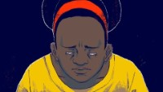
What is Domestic Abuse
Notes:
Trainer Notes:
Play until 1.35 mins.

Slide 6





Why is gender/sex important?
Notes:
Trainer Notes:

Slide 7


Typologies of Abuse
Situational couple violence/abuse
Although the individual is violent/abusive, neither party is violent/abusive and controlling
Coercive Control/intimate terrorism
The individual is controlling and abusive, the partner is not
Violent resistance
It is the partner who is abusive and controlling, the individual is violent not controlling
(Michael P. Johnson)
Notes:
Trainer Notes:

Slide 8
Statistical Reality
93% of murders are committed by men (source slide 1)
Less likely to suffer domestic abuse and less likely to be repeat victims (source slide 3)
Less likely to be seriously hurt or killed than women (source slide 3)
An average of 2 women a week are killed by an ex or current partner
Of all female homicide victims 71% are killed at home
In 99% of cases where a woman was raped or subjected to assault by penetration, the perpetrator was a man
86% of those women knew the perpetrator (All - source slide 2)
Notes:
Trainer Notes:

Slide 9
Typologies of Abuse
Situational Couple violence/abuse | Coercive Control (CCB) | Violent Resistance
Not gendered | Disproportionately committed by men against women | Disproportionately committed by women against men
No power imbalance | Motivated by sense of entitlement | Committed by primary victims of CCB, against their abusers
Neither party lives in fear of the other | Driven by a need for Power & Control | Genuine remorse shown and feelings of guilt and self-blame common
Genuine remorse shown | Underlying sense of ownership | Motivated by desire to reclaim dignity, escape, self-defence etc.
Driven by poor emotional responses | Bespoke, tactical, strategic range of behaviours designed to oppress | Escalates risk to person committing it from the primary abuser
Not motivated by a desire to control or oppress | Lack of empathy and remorse | Can be fatal
Notes:
Trainer Notes:

Slide 10
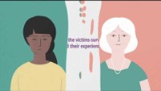
What is Domestic Abuse
Notes:
Trainer Notes:
Slido Poll with Open text responses, then facilitated group discussion.

Slide 11

Impact on victims
Fear Hopelessness
Confusion Depression
Hope Self hatred
Mistrust Headaches
Love/ hate Gastrointestinal issues
Exhaustion Alcohol and substance Chronic fatigue misuse
Hypervigilance Distressed
Exaggerated startle Trauma
response Angry
Unstable mood Ashamed

Slide 12
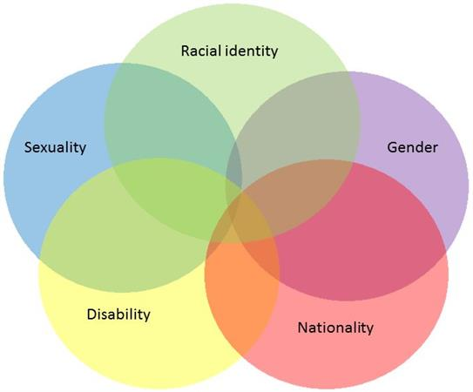
Intersectionality
What barriers may be present for victims from marginalised communities?

Slide 13

Intersectionality
Women’s Aid – Deserve to be heard

Slide 14
Unhelpful things to avoid saying
We can keep you safe
You need to leave him/her
You need to fight back, stand up for yourself
Your partner is a bad person
Don’t go back if it’s that bad
You need to leave them
Get someone to have a word with them, a friend, family member to tell them to stop
You need to leave for the kids' sake
You are a victim and need protecting

Slide 15
Helpful things to say
You are safe here and can stay as long as you need
It sounds like you are dealing with a very difficult situation
No one deserves to be made to feel afraid or be harmed
Everyone deserves to feel loved and safe
I can see how hard this is for you and we can get you some support
If this was happening to friend, what advice would you give them?
Have you spoken to anyone about it? Did you know there are independent specialists who can support you?
Would you like me to refer you to some support, so someone can talk to and help you keep decide what to do?
There is no judgement here, what do you need?

Slide 16
Specialist Support
Domestic Abuse Outreach Services
Outreach services offer an independent, confidential, listening service to anyone affected by domestic abuse.
They are free and impartial services, which can assist by giving practical help and emotional support as well as providing information on a wide range of issues including housing, benefits, safety planning and the needs of children affected by domestic abuse.
They can also assist with accessing refuge accommodation if you/someone you are supporting needs to leave home in order to remain safe.

Slide 17
Local Surrey Domestic Abuse Services
Surrey Domestic Abuse Helpline Tel:
01483 776822 (9am to 9pm 7 days a week) provided by YourSanctuary
East Surrey Domestic Abuse Services (ESDAS) – on 01737 771350 (Covering Reigate and Banstead, Mole Valley and Tandridge)
YourSanctuary – on 01483 776822 (Covering Woking, Runnymede and Surrey Heath)
North Surrey Domestic Abuse Outreach – on 01932 260690 (Covering Epsom & Ewell, Elmbridge and Spelthorne)
South West Surrey Domestic Abuse Outreach – on 01483 898884 (Covering Guildford and Waverley)

Slide 18

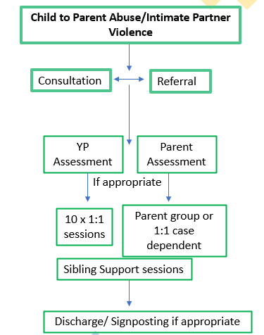


YUVA (YOUTHS USING VIOLENCE AND ABUSE) A Programme for the WHOLE FAMILY
Who is YUVA for?
Young people using abuse
(10 1:1 Behavioural change focused sessions)
Parents/Carers
(9-week Psychoeducational support group)
Teens using IPV and their partner/ex-partner
(1:1 sessions)
Siblings
(support sessions)
Referral Criteria
YP aged 11-18 (up to 25 with additional needs)
Cannot work with YP if there is ongoing adult domestic abuse in the home
Consent needed from both parent and YP
Self referral is possible but professionals will be contacted
Engagement needed from parent if YP engages in services
Parent can engage without YP, but YP needs to be within referral age range
Engagement with partner/ex partner or sibling of teen using IPV, only if teen using IPV is engaging
Service Process
Contact dvip.yuva@richmondfellowship.org.uk for more information or to schedule a consultation

Slide 19

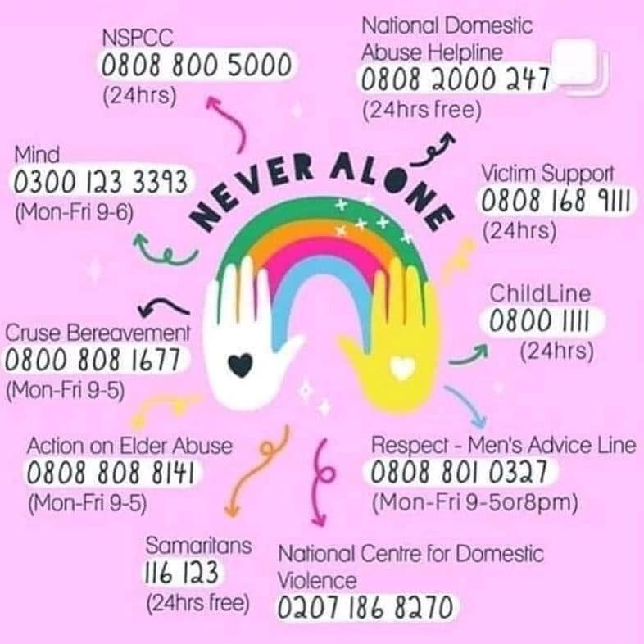
Support Services

Slide 20

Thank you! Any Questions?

Slide 21
Useful Links
Respect
Healthy Surrey - Domestic Abuse
Interventions Alliance behaviour change programmes
How Domestic Violence Perpetrators Manipulate Systems
Bowen-2020-Coercive-control-of-women-as-mothers-via-strategic-mother-child-separation
What Works? Summary of Domestic-violence-perpetrator-programmes

