Slide 1

Introduction to the Adult Social Care Multi Agency Safeguarding Hub (ASC MASH)
Peter Rice Team Manager ASC MASH October 2024

Slide 2
Structure of the presentation
What is the Adult MASH? (slides 3-8)
What is an Adult at Risk? (slides 9-10)
What makes a good safeguarding referral? (slides 11-19)
How to make a safeguarding referral. (Slides 20 – 23)
Recommended further reading.
Recommended links.
Notes:
Source: Prince, M et al (2014) Dementia UK

Slide 3



What is the Adult MASH?
Notes:
1. https://www.gov.uk/government/publications/new-government-domestic-violence-and-abuse-definition/circular-0032013-new-government-domestic-violence-and-abuse-definition
2. https://www.surreysab.org.uk/information-for-professionals/domestic-abuse/
3. https://assets.publishing.service.gov.uk/government/uploads/system/uploads/attachment_data/file/1089015/Domestic_Abuse_Act_2021_Statutory_Guidance.pdf

Slide 4
The Role of ASC MASH
The ASC MASH are the central hub for safeguarding concerns relating to ‘Adults at Risk’ who have experienced or are at risk of experiencing abuse or neglect while in Surrey county, ensuring immediate protection measures are in place and work alongside a centralised hub of safeguarding partners to support in gathering information to inform decision as to whether a Section 42 (Care Act, 2014) safeguarding enquiry is needed.
The MASH undertake enquiries where the person is not already known to a Surrey adult social care team or otherwise refer out to other Adult Social Care teams with any relevant recommendations and information gathering from MASH partner agencies Children’s Social Care, Police, SABP).
Screen Prevent referrals relating to adults.
Respond to Children’s MAPEs.
Complete individual checks for partner safeguarding agencies where appropriate.
Contribute to discussions and decisions about Domestic Violence Disclosure Scheme (DVDS) and Child Sex Offender Disclosure Scheme (CSODS).
Liaise with ASC Quality Assurance colleagues and Safeguarding Advisors to identify concerns within ASC provider quality alert themes and trends, and plan for response to any such identified concerns.

Slide 5
ASC MASH Staffing
The ASC MASH consists of:
Senior Administration Advisor (x1) – Responsible for line management of our administration team and coordination of administration activity at MASH operational levels.
Administration Coordinators (x3) – Responsible for screening any information received into the MASH and providing an initial stage screening and assigning to the appropriate area in MASH or other ASC team for follow up. Constant monitoring of referrals received into the MASH during operational hours. Managing initial contact with callers into the MASH.
Social Care Assistants (x4) – Initial stage practitioner grade screen & triaging of safeguarding concerns received into the MASH and documenting initial records of decision-making rationale. Liaison with partner agencies to gather further information to inform triaging decisions.
Social Workers (x3) – Allocation of safeguarding concern cases. Gathering of information relating to the concern to ensure immediate protective measures are taken with the person and any relevant stakeholders in their care and support, and decision as to whether a Section 42 enquiry (Care Act, 2014) is required. Completion of Section 42 enquiries where necessary.
Senior Social Workers (x1.5) – Same functions of Social Workers (see below) but with addition of senior functions to support MASH Senior team.
Assistant Team Managers (x2) – Assurance checks of all decision making within the MASH. Support to the team manager in overseeing day to day operational functions of the MASH. Ongoing review of operations both internally and with partner agencies.
Team Manager (x1) – Operational and strategic lead of the MASH. Ensuring the MASH are practicing in accordance with legislation, its associated guidance and best practice guidance and responding to the unique demographic and needs of Surrey residents.

Slide 6
Partner Working
We work closely with:
Police SPA – Screening and sharing of any information from Police sources (received via Single Combined Assessment of Risk form [SCARF]) relating to Children and/or Adults at Risk with partner agencies as appropriate and in line with health and social care legislation and guidance.
Children’s SPA – Provide the initial point of contact for anyone wishing to receive a service, identified as in need of a service, or share information with Children’s Social Care. Screen and share information from Childrens Social Care sources with partner agencies as appropriate and in line with health and social care legislation and guidance.
Surrey & Borders NHS Partnership Trust (SABP) – SABP provide secondary mental health care for Surrey residents and manage Section 136 assessment suites and NHS psychiatric hospitals in Surrey.
Health services - (Community Nurses and Hospital safeguarding leads).
We also can gather information from other partners, such as:
GP Practices
Catalyst (in relation to support for victims of Cuckooing)
District & Borough Councils
Domestic Abuse Outreach services
Surrey Fire & Rescue
Trading Standards

Slide 7
ASC MASH caseload
Some quantifiable statistics:
829 Safeguarding concerns contacts were received and processed to social care records by ASC MASH in Oct 2024 – This occurs when an initial referral screening decision has been made that a potential Adult at Risk has been identified and therefore the concern is progressed to a formal safeguarding process under S42.
Approximately 2700 other contacts were received and triaged that did not result in progression to an Adult Safeguarding case.
As of 1st October 2024 there are 550 open safeguarding cases held within the ASC MASH. Of these cases;
40 cases awaiting allocation to a Social Worker for completion of safeguarding work. 3 Family and Private Life cases 26 Community Provider concern cases
175 cases allocated to our Health Provider Liaison staff, across the 6 acute hospital sites and the 2 major community health commissioners (Surrey Downs and CSH).
199 cases assigned to MASH Overtime staff.
20 cases in medication error concerns tray (screened, triaged and terms of reference with provider, awaiting responses).
120 cases allocated to MASH Social Worker’s for completion of safeguarding work.

Slide 8
ASC MASH is not:
A gateway to reporting crime. If you suspect a crime has occurred, you need to report this to Police via 101 or 999 in an emergency.
A way to request an assessment for someone who appears to have a need for care and support. You should make a referral to the Advice & Information Service via the Professional Portal.
A service for people in crisis due to their mental health. If you have concerns that someone may harm themselves, you should:
Report to police if you believe they are at immediate risk.
Advise them to contact their GP or the SABP Crisis Line on 0800 915 4644.
Contact the SABP Crisis Line yourself who can advise you.

Slide 9
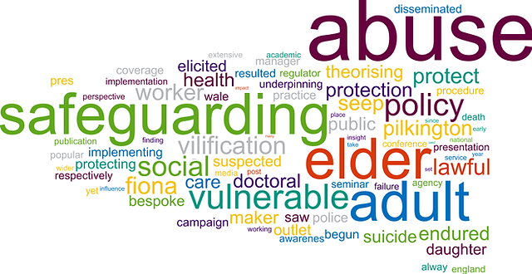
What is an Adult at Risk?
Notes:
1. https://www.gov.uk/government/publications/new-government-domestic-violence-and-abuse-definition/circular-0032013-new-government-domestic-violence-and-abuse-definition
2. https://www.surreysab.org.uk/information-for-professionals/domestic-abuse/
3. https://assets.publishing.service.gov.uk/government/uploads/system/uploads/attachment_data/file/1089015/Domestic_Abuse_Act_2021_Statutory_Guidance.pdf

Slide 10
Adult at Risk
An ‘Adult at Risk’ refers to the Care Act (2014) Section 42(1) three-part criteria used by Local Authorities to identify Adults who have additional needs that require consideration in the context of protecting them. The three-part criteria is as below: [The adult:]
(a)has needs for care and support (whether or not the authority is meeting any of those needs),
(b)is experiencing, or is at risk of, abuse or neglect, and
(c)as a result of those needs is unable to protect himself or herself against the abuse or neglect or the risk of it.
In order for the Local Authority to determine if the person is an Adult at Risk, we:
Consider the information received in the referral.
Speak directly to the adult who is the subject of the concern raised, their carers (informal and professional) and any agencies involved with them as appropriate.
Review health and social care records for any relevant information about the adult including their history and needs.

Slide 11

What makes a good safeguarding referral?
Notes:
1. https://www.gov.uk/government/publications/new-government-domestic-violence-and-abuse-definition/circular-0032013-new-government-domestic-violence-and-abuse-definition
2. https://www.surreysab.org.uk/information-for-professionals/domestic-abuse/
3. https://assets.publishing.service.gov.uk/government/uploads/system/uploads/attachment_data/file/1089015/Domestic_Abuse_Act_2021_Statutory_Guidance.pdf

Slide 12
How do I decide if a safeguarding referral is necessary?
It is important for professional referrers to consider if referral for safeguarding is the most appropriate referral pathway.
There are instances where safeguarding referrals are received, however upon gathering further information it is apparent the concern relates to an unmet need where a Section 9 needs assessment (Care Act, 2014) is most appropriate. This is particularly relevant in instances of self-neglect, and it is for this reason that the Surrey Safeguarding Adults Board (SSAB) advise that: “the starting point will be an assumption that an adult safeguarding enquiry is not the best response to a concern about self-neglect or hoarding”
However, it is important to still consider the Adult at Risk criteria and severity of risk in this instance, as there are indeed instances in the case of self-neglect and hoarding where a safeguarding referral will be necessary.
Surrey County Council and the SSAB have developed a ‘Levels of Need’ document which can help professional referrers decide the best pathway for referral. This is available at the link below and contained in the next three slides for ease of reference.
https://www.surreysab.org.uk/wp-content/uploads/2020/08/Adult-Social-Care-Level-of-Need-V3-August-2020-.pdf

Slide 13
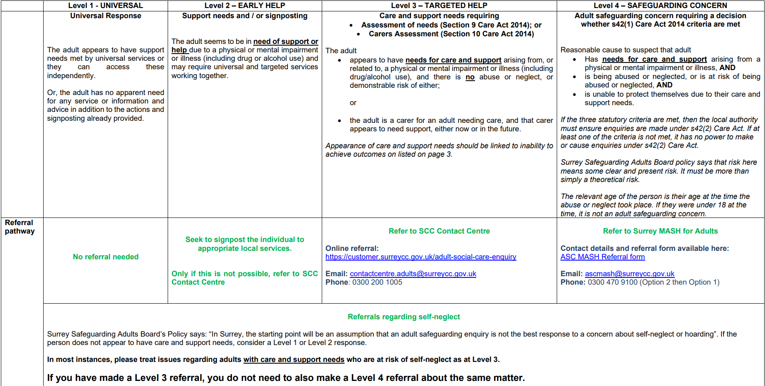

Slide 14
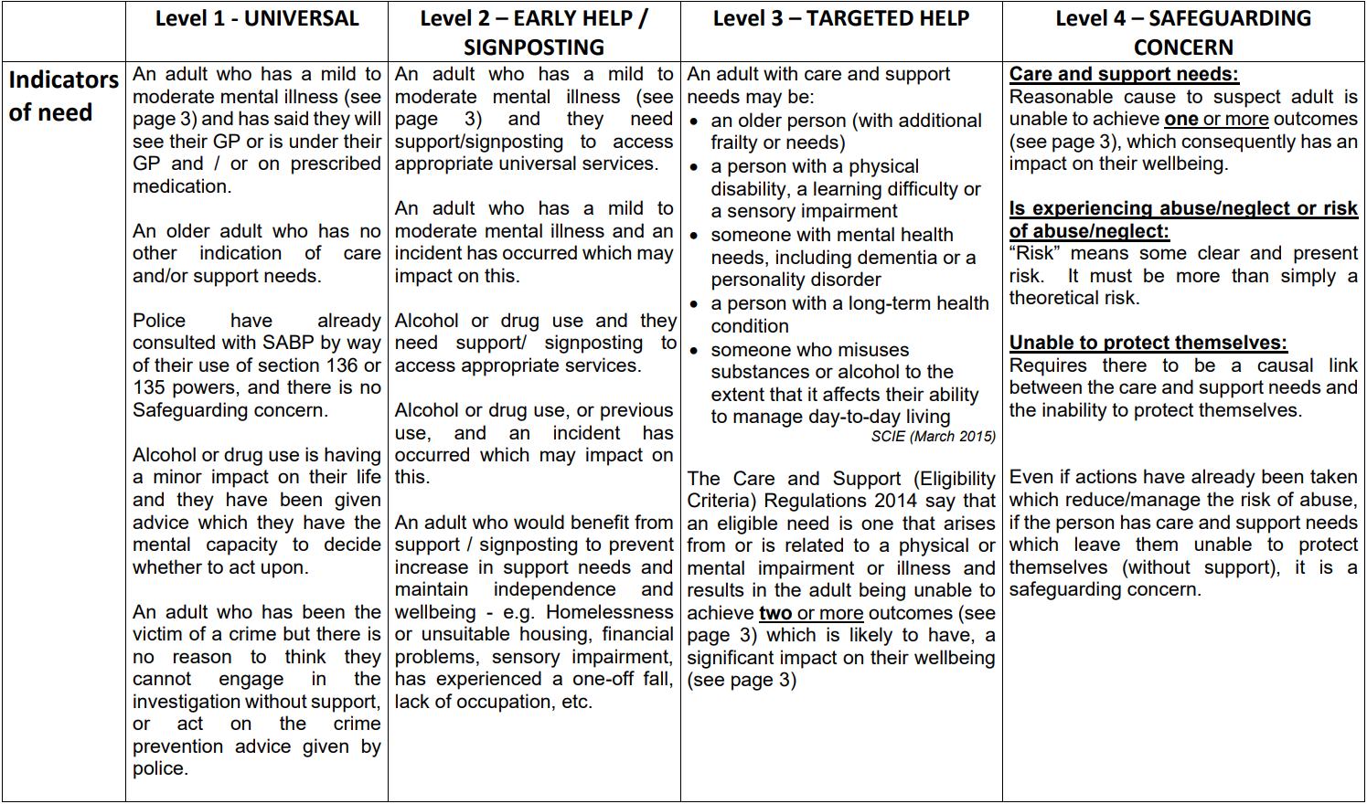

Slide 15
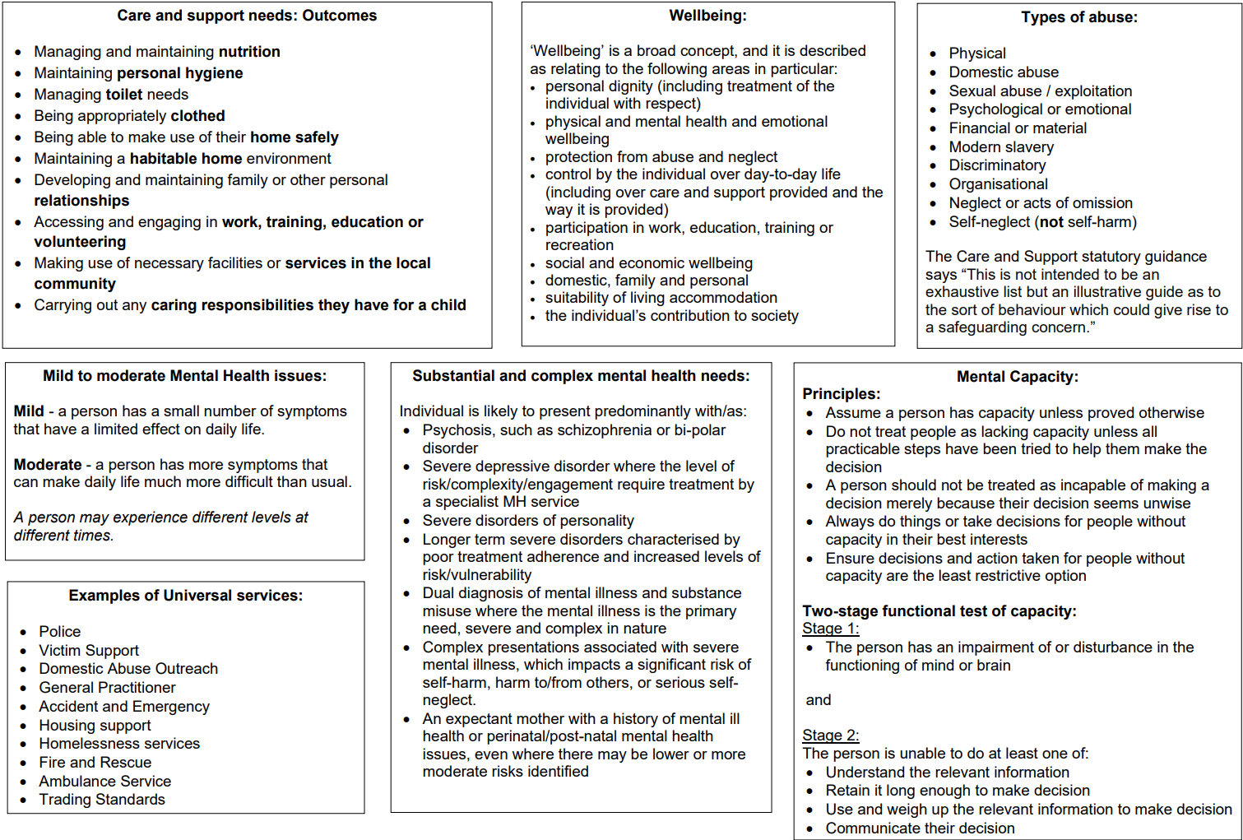

Slide 16
Providers: When is a safeguarding referral necessary?
GREEN - Non-reportable
A low-level incident or concern where the criteria for a safeguarding enquiry is unlikely to be met – and as such should not be reported as a safeguarding concern. The incident should be recorded in line with internal organisational procedures and action taken to resolve, and reported to ASC Quality Assurance team where relating to a community care provider.
AMBER – Requires Consultation
The incident or concern should be recorded in line with internal organisational procedures. Consultation should take place with your organisation’s safeguarding lead, taking into account relevant internal policies and procedures. Take actions to reduce risk and consider whether consultation with the partner organisation is also necessary.
RED - Reportable
It is likely that the concern will meet the criteria for a safeguarding enquiry, and it should be reported to the local authority.

Slide 17
Providers: Actions already taken
When something does not go as planned, providers invariably follow their own internal safeguarding policies and procedures, including taking action to determine how the incident happened and steps to reduce the risk of it happening again.
Providers also have a Duty of Candour to inform the person, or an appropriate advocate, about what has gone wrong and what action they have taken. This should also involve determining if the adult or their representative is satisfied with that action.
It is important this information is included within the referral as this enables an appropriate decision to be made as to whether a Section 42 enquiry is needed, and if so to support the enquiry process to be completed in a timely and proportionate way.
If this information is not known at the time of referral, the initial enquiry response could be as simple as sharing the report that was generated from the referrers own internal action, requesting them to respond to missing information pertaining to what action has been taken to rectify the incident.

Slide 18
Information Required for a Safeguarding Referral
A referral with adequate information is crucial, as it helps us to confirm the person is an Adult at Risk and that effective protection measures are in place or to effect protective measures as quickly as possible. Referrals from professionals should come via the Online Referral Portal wherever possible, and include: a
Full details of the adult as well as the source of risk (whether this is another named individual or an organisation).
Description of what has happened and why you are concerned about abuse or neglect (or the risk of it).
Detail of any communication needs the adult may have.
Information about the adult’s care and support needs or appearance of them.
Actions taken to make the adult (and others where applicable) safe.
Confirmation that you have informed the adult about the referral, and if you have not informed them, an explanation as to why not.
Confirmation of what the adult (or their representative) would like to happen as a result of your referral.
Full details of any known individuals or organisations involved in the care and support of the adult.

Slide 19
Referral Pitfalls
Some issues with referrals can include:
Not informing the adult (or a suitable independent representative) about the referral and understanding what they would like to happen.
Not giving enough information about the concern.
Not detailing what actions have been taken to address any immediate protection concerns.
Not informing the police where a crime is suspected to have been committed.
Referrer not being available to discuss the concerns further where necessary.

Slide 20

How to make a safeguarding referral

Slide 21
How to make a safeguarding referral
Most safeguarding referrals received come from professional sources, however anybody can make a safeguarding referral, including the Adult at Risk themselves if they are able. In all cases it remains important that we receive as much information about the circumstances as possible. It is however recognised that in many cases members of the public are unlikely to have knowledge of safeguarding procedures and may also have needs for care and support themselves which impact their ability to communicate information fully. Therefore, the following routes are available for members of the public to make a safeguarding referral: a
Telephone: 0300 200 1005
Online: Adult Safeguarding Referral online form
Textphone (via Text Relay): 18001 0300 200 1005
SMS: 07527 182 861 (for the deaf or hard of hearing)
VRS: Sign Language Video Relay Service
Out of hours: Emergency Duty Team 01483 517898

Slide 22
What happens next?
The referral is screened the same day (or next working day).
If the adult is already open to an adult social care team, then the referral is passed directly to that team who should then respond to the referrer.
If the referral is identified as not being a safeguarding concern, it is passed to the most appropriate team (typically the Information and Advice team) and the referrer is responded to with appropriate advice.
Safeguarding concerns held by the ASC MASH team are assigned a priority rating which dictates how quickly the safeguarding task is allocated to a social worker.
Social Workers review information on our systems and request for information from other partners as appropriate and then make the Section 42 decision as to whether further enquiries are needed.
Non-complex enquiries relating to medication errors, or concern about an Acute Hospital or Community Health Provider where the person is unknown to a community social care team are currently completed by ASC MASH.
MASH provide guidance, information from and contact details for partners who need to be involved in the enquiry.

Slide 23
Will I receive feedback?
Yes. We are committed to ensuring every referrer is responded to where possible (i.e. wherever the referrer has provided their contact information) to inform them of the outcome of the referral triage decision and providing any relevant advice and information.
It would be appropriate for you to receive feedback about a S42 enquiry including its outcomes if:
You would have a role in the enquiry.
where you have an ongoing support role with the adult.
If the adult gives their consent for you to have feedback.
It is not appropriate for you to receive feedback outside of these circumstances as the concern is either about another provider or about something that is happening in someone’s private and family life where their consent has not been obtained and GDPR exemptions are not met.
The action that we take for one referral should not influence you in making any future referrals – sometimes a S42 decision can change based on escalation of concerns, and it is crucial information is shared to support the Local Authority in identifying ongoing risks and escalations.

