Slide 1







Motor Neurone Disease
A Brief Overview

Slide 2
Claire Bennett: rare Neurological Disorders Specialist Practitioner
Surrey Downs Health & Care
c.bennett21@nhs.net

Slide 3
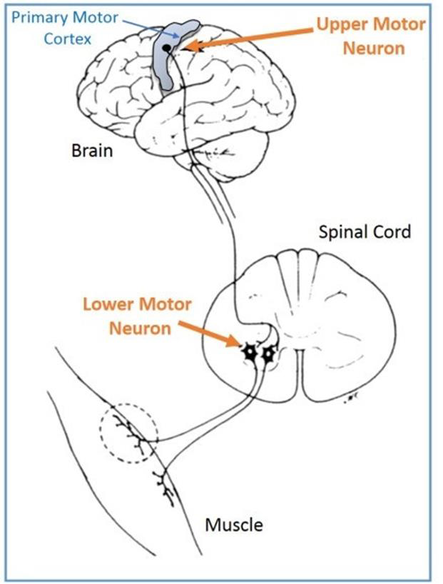
WHAT IS MND
???

Slide 4
WHAT HAPPENS :
Messages from the motor neurones gradually stop reaching the muscles. This leads the muscles to weaken, stiffen and waste, which can affect how you walk, talk, eat, drink and breathe. Some people also get changes to their thinking and behaviour, but the disease affects everyone differently. Not all symptoms will affect everyone, or in the same order. Symptoms also progress at varying speeds, which makes the course of the disease difficult to predict.

Slide 5
DEMOGRAPHICS
WHO DOES IT AFFECT
5000 people at any one time in the UK
Risk = 1/300
Any age, but more likely over 50`s.
Men & women
No known cause, no known cure.

Slide 6
Types of MND
Amyotrophic Lateral Sclerosis (ALS)
Most common
Weakness and wasting in the limbs, muscle stiffness & cramps
Initially may report tripping / dropping things
Life expectancy = 2-5 years from onset of symptoms

Slide 7
Bulbar onset MND or Progressive bulbar palsy (PBP):
PBP affects a smaller number of people
Mainly affects the muscles of the face, throat and tongue.
Early symptoms may include slurring of speech or difficulty swallowing.
Life expectancy is between six months and three years from onset of symptoms.

Slide 8
Progressive muscular atrophy (PMA):
PMA affects only a small proportion of people.
Early symptoms may show as weakness or clumsiness of the hands.
Life expectancy is usually more than five years.

Slide 9
Cont.
Primary lateral sclerosis (PLS):
PLS is a rare form of MND
mainly weakness and stiffness that usually begins in the lower limbs,
many people experience additional problems with their speech and various other symptoms.
Life expectancy can be 10 – 20 years or more.
Kennedy’s disease (also known as spinal bulbar muscular atrophy or SBMA):
While not a type of MND, Kennedy's disease has similar symptoms.
Caused by a genetic mutation.
It is a rare condition affecting the motor neurones, with increasing weakness and wasting of the muscles.
Causes hormonal changes.
Life expectancy = average life span

Slide 10
Facial Onset Sensory Motor Neuropathy (FOSMN)
Atypical motor neurone disease.
Thought to be exceptionally rare. Only 100 people to date have been written about.
Categorized by asymmetrical / symmetrical facial numbness / sensory abnormalities which may spread to the scalp, neck, upper trunk and extremities.
The muscles of respiration and swallowing may become involved.
Typically progresses from the head to lower body sequence.
Some people experience FTD

Slide 11
Motor neurone disease kills a third of people within a year and more than half within two years of diagnosis.

Slide 12
What`s the treatment plan
What`s next?
There is no cure
Riluzole
Realistic expectations
Preparing for the future
Symptom Management
Quality of life

Slide 13
Management team
Consultant Neurologist
Specialist MND team – King`s, St. George`s,
GP
Specialist Practitioner
Community neuro team – OT, physio, SLT, dietetics
Hospice – OT, physio, specialist nurses, SW
Adult Social Care – OT physio, SW`s
County Councils – OT`s physio`s, SW
Charitable organizations such as the MNDA

Slide 14

Contact information MNDA
https://www.mndassociation.org/
MND Connect Helpline: 0808 802 6262

Slide 15

“
“ Remember to always look up at the stars and not down at your feet. Try to
make sense of what you see and wonder what makes the universe exist.
Be curious.
And however difficult life may seem, there is always something you can
succeed and be good at.
It matters that you don`t give up”
Stephen Hawking

Slide 16
Any Questions?

Slide 17

Sam was one of you, he had worked in the care sector for over 30 years. He was a good person, full of kindness and with the biggest heart. He was the best dad in the world and, was loved and admired by all those who knew him.
He knew what was happening, but didn’t think you cared about what really mattered to him, which was to be near to us, and to be cared for with the support he needed, just as he had provided the same to 100s and 100s of people with care needs.
We get MND is complex, but when you’re working with a deteriorating condition with an indeterminate longevity, please know time is really of the essence, knowing what’s the priority is essential, keeping to your promises, invaluable, and the most important person in an MDT is the person themselves.
Please imagine our dad, was your dad, your husband or son and think about how you would have wanted their support to work, and their end of life to be the best it could be. It was truly terrible for our dad and us, but knowing you care what happened, you’ll learn from it and share this with others to make a real difference now to those who you work with, will give us some meaning and comfort. So, please, please, keep our dad’s story alive so that there is an authentic and tangible worth for others you are there to help.
(Sam’s sons, aged 15 and 18 when he passed.)

Slide 18

Sam – a real person
A father to two teenage sons
A brother
A friend and family member to his ex-partners
A hardworking and thoughtful care worker
A vibrant, private, talented, strong human being
A man who died at age 60 from Bronchopneumonia, Motor Neuron Disease, and malnourishment

Slide 19
Key thought…
The main concern arising from this review is not that Sam died, but that his life was foreshortened, the end of his life was not what it could have been, was not as he wished it to be, and it was an experience described by his family as “truly terrible”.
In Sam’s own words “I have had lots of support but not the support I want.”
This review highlights that Safeguarding Adults is not just about maintaining a level of activity, but also developing an awareness of what we are doing and how it impacts the person(s) concerned.

Slide 20
Sam’s experience
Coming to terms with an emerging terminal diagnosis
Struggling with activities of daily living
Living alone, semi-isolated
Wanting to move to be nearer his sons
Experiencing low-mood and/or depression
Working from home, gradually becoming less able to work
Receiving input from a large number of agencies and professionals
Losing weight rapidly and experiencing pain and fatigue
Gradually becoming disenchanted with support available
Unable to use a direct payment arrangement and having no formal care package for several months

Slide 21
Findings (1/5) – Coordination of Support
A pattern of divergence between Sam and the professionals around him
Timely assessment under The Care Act (2014)
Ensuring full representation at multi-disciplinary meetings
Listening to and acting upon the views of the person

Slide 22
Findings (2/5) – Mental Capacity
The possible impact of Motor Neuron Disease upon mental capacity and executive function
Curiosity regarding mental capacity, listening beyond the person’s words
In the absence of mental capacity self-neglect may become straightforward neglect
The need to take reasonable steps to establish mental capacity

Slide 23
Findings (3/5) – Communication
Recognising the impact of professional communication from the person’s point of view
Attention to communication needs
Identifying when communication channels are starting to break down
Characterisation of disengagement as service refusal or “not wanting support”
Timing and sequencing

Slide 24
Findings (4/5) – Safeguarding (Section 42)
Consideration of a safeguarding response to indicators of self neglect (more on this later)
The importance of consideration of mental capacity when a person is at high risk
Recognising the dangers of disengagement and isolation

Slide 25
Findings (5/5) – Other findings
The importance of understanding and executing operational policies relating to support
The importance of considering interim care arrangements

Slide 26
Sam – A reflection on the learning
Early engagement of social care
Coordinated and informed support
A clearer picture of Sam’s mental capacity and mental health
Meaningful responses to indicators of self-neglect and disengagement
“I have had lots of support but not the support I want.”

Slide 27
A reflection on the matter of ‘self neglect’
Jem Mason SAR Author
and Jane Hughes Adult Safeguarding Consultant

Slide 28
Do we all know and understand what self neglect is?
There is no single operational definition of self-neglect, however the Care Act 2014 makes it clear that it comes within the statutory definition of abuse or neglect if the individual concerned has care & support needs and is unable to protect themselves from neglect
The DOH (2016) defines it as a ‘wide range’ of behaviours neglecting to care for one’s personal hygiene health or surroundings and include behaviours such as hoarding
Lack of self care – this includes neglect of one’s personal hygiene, nutrition and hydration, or health, to an extent that may endanger safety or well- being
Lack of care of one’s environment- this includes situations that may lead to domestic squalor or elevated levels of risks in the domestic environment(e.g. health or fire caused by hoarding)
Refusal of assistance that might alleviate these issues. This might include, environment or of health assessments or interventions, even if previously agreed, which could potentially improve self- care or one’s environment
According to statutory guidance, self-neglect is considered a form of abuse and neglect. This includes behaviors such as neglecting personal hygiene, health, or surroundings, and can involve hoarding.

Slide 29
Self-Neglect
The concept of self-neglect is complex with contrasting definitions
Decision making is a key pivot upon which professional responses to self- neglect turn
Interventions in self neglect requires careful exploration in the context of the principles of personalisation, choice, control & empowerment that underpin policy in adult social care and safeguarding.

Slide 30
Self-Neglect in Surrey
It should be noted that in Surrey not all cases of self-neglect prompt a s42 enquiry
The Adult Social Care Levels of Needs says" In Surrey, the starting point will be an assumption that an adult safeguarding enquiry is not the best response to a concern about self-neglect or hoarding”.
In most instances, issues regarding adults with care and support needs who are at risk of self-neglect should be seen as a Level 3 need, which would trigger an assessment of need and / or a carers assessment
A Level 4 need would require a safeguarding concern to be raised:
where there are concerns of self neglect and the concerns were about failures by agencies or professionals to work together to assess and manage risks effectively
Where the adult is at risk because of the care that they need, or access to facilities to support them, is being prevented by another person
Where there are concerns that the adult is unable to protect themselves by controlling their own behaviour
The adult lacks mental capacity and is unable to understand the risks and control the situation.

Slide 31

Was there a point in which there were concerns about Sam, that were indicators of self-neglect?
The Surrey Levels of Need guidance says….
Self-neglect is where there is significant risk associated with:
Wellbeing that is affected on a daily basis
Care, treatment or some other intervention is being refused
The person refuses to engage with necessary services
Hygiene is poor and causing other risks such as skin problems
Hoarding where there is significant risk associated with a risk of fire Urgent health and safety risks o Pending enforcement action creating risk of losing home
A vulnerable person living where facilities have been disconnected.

Slide 32
How can a S42 Enquiry help?
Section 42 (s42) enquiries can help in cases of self-neglect. Under the Care Act 2014, local authorities have a duty to make, or cause to be made, enquiries if they reasonably suspect that an adult with care and support needs is experiencing, or is at risk of, abuse or neglect, including self-neglect
The purpose of an s42 enquiry is to determine what action, if any, is needed to prevent, reduce, stop the abuse or neglect and to protect the adult in question
This process involves:
Assessing the Situation: Gathering information to understand the extent of the self-neglect and its impact on the individual's wellbeing
Involving the Individual: Taking into account the adult's views, wishes, and desired outcomes, this could include, involving their family, friends and social networks
Multi-Agency Collaboration: Working with other agencies and professionals who may already be involved with the individual to ensure a coordinated, person-centred response
Developing a Plan: Creating a plan with / for the adult that addresses the identified risks and supports the individual's needs.

Slide 33
cont.
The care act guidance offers a clearer framework for working with self neglect recognising the benefits of social work involvement where serious of harm is identified
The care act gives the multi-agency framework 14.12 (care act guidance) Creates strong multi-agency partnerships that provide timely & effective prevention of and responses to abuse or neglect
There is a view that where there is considerable risk the safeguarding framework is best approach to be adopted due to it links with partner agencies.

Slide 34
Learning from Safeguarding Adults Reviews 2nd national SAR Analysis
The most commonly noted practice shortcomings were poor risk assessment/risk management (in 82 per cent of cases), shortcomings in mental capacity assessments (58 per cent), and lack of recognition of abuse/neglect (56 per cent). Also frequently highlighted were shortcomings in making safeguarding personal (50 per cent), absence of professional curiosity (44 per cent) and attention to care and support, physical and mental health needs, each noted in around 40 per cent of cases. An absence of professional curiosity meant that circumstances were sometimes taken at face value rather than explored in detail. Other highlighted shortcomings included absence of legal literacy, superficial acceptance of individuals’ apparent reluctance to engage, poor recognition of the impact of trauma and attention to people’s living conditions.
Shortcomings in use of the Care Act 2014 section 42 safeguarding provision, and of multi-agency risk management meetings were each noted in around 38 per cent of cases. Also regularly featured were concerns about the quality of recording, how agencies understood their roles and responsibilities, and how services communicated across local authority and other boundaries.

Slide 35
Learning from Safeguarding Adults Reviews 2nd national SAR Analysis
The most frequently mentioned organisational features that impacted on practice were poor management oversight, poor use of policies and procedures, and pressures on staffing and workloads, present in over a quarter of cases.
Failure to provide training and concerns about commissioning practice, including quality assurance of provider services and communication about ‘out of authority’ placements, were also noted, along with an absence of suitable, often specialist, resources
These factors compromise the effectiveness of safeguarding, but they also have a direct influence on how practitioners in any one agency approach their work.

Slide 36
Key messages from the 2nd SAR Analysis
Explicit and comprehensive risk assessment is an essential component of practice, as is a focus on proportionate risk management
It is vital that practitioners pay close attention to mental capacity, carrying out capacity assessments where indicated, particularly where an individual consistently disregards high levels of risk to themselves or others, and where there might be concern about executive function, for example as a result of the impact of acquired brain injury or prolonged alcohol dependency. The potential impact of impaired executive brain function on decision-making must be considered
The multitude of potential pitfalls in adult safeguarding, illustrated by the wide range of shortcomings set out above, means that practitioners must be competent and confident across a wide range of knowledge and skills. SARs also commented positively on the personal qualities that practitioners brought to their work. Compassion, kindness, care, empathy and sensitivity were all noted as good practice, along with commitment, dedication, professionalism, skill and diligence
It is important continuously to reflect on the demands that safeguarding practice makes on practitioners and to identify how continuing professional development can support knowledge and skill development and the ability to use personal qualities in professional practice.

Slide 37
Key messages cont.
Factors such as poor case coordination and information-sharing, pressures on staffing and workloads, availability of commissioned resources, and absence of management scrutiny, training and guidance, compromise the effectiveness of safeguarding. They have a direct influence on how practitioners in any one agency approach their work with an individual
Practitioners’ awareness of these systemic factors can assist them to take appropriate actions, for example to contribute actively to interagency coordination and information-sharing, and to escalate difficulties to the appropriate level in the safeguarding system.

Slide 38
A Section 42 enquiry can make a significant difference in addressing self-neglect and other forms of abuse or neglect. Here are some key impacts:
Identification of Needs: The enquiry helps to identify the specific needs of the individual, including any underlying issues contributing to self-neglect
Protection and Safety: It aims to determine what actions are necessary to protect the individual from harm. This might include creating a safeguarding plan to address immediate risks
Multi-Agency Collaboration: s42 enquiries often involve multiple agencies working together, such as social services, healthcare providers, and community organizations. This ensures a comprehensive approach to support
Empowerment and Involvement: The process involves the individual in decision-making as much as possible, respecting their views and wishes. This can empower them to take an active role in their own care and support
Long-Term Support: Beyond immediate protection, the enquiry can lead to ongoing long-term support plans that address ongoing needs and help prevent future instances of self-neglect
Overall, an s42 enquiry provides a structured and thorough approach to safeguarding, ensuring that the individual's wellbeing is prioritized and that they receive the necessary support and protection.
Would this have made a difference for Sam?

