Slide 1





Changing Futures Surrey
Bridge the Gap
Prevention Programme

Slide 2
Principles and ambitions
Work in partnership across local services and the voluntary and community sector, building strong cross-sector partnerships at a strategic and operational level that can design and implement an improved approach to tackling multiple disadvantage.
Coordinate support, and better integrate local services to enable a ‘whole person’ approach.
Create flexibility in how local services respond to the people who use them, taking a system-wide view with shared accountability and ownership leading to better services and a ‘no wrong door’ approach to support.
Involve people with lived experience of multiple disadvantage in the design, delivery, and evaluation of services and in governance and decision making.
Take a trauma-informed approach across the local system, services and in the governance of the programme.
Commit to drive lasting system-change, with sustainable changes to benefit people experiencing multiple disadvantage beyond the lifetime of the funding.

Slide 3
Introducing Surrey County Council’s Multiple Disadvantage Health and Well-Being Team
Phillip Austen-Reed
Public Health Principal
Collette Le Van-Gilroy
Senior HWB Policy & Programme HHMB, Changing Futures
Julie Shaw
Senior Partnership & Programme Manager, Surrey Adults Matter (SAM)
Tyla Bailey
Business Support Officer Changing Futures
Lisa Byrne
Changing Futures Programme Manager
Paul Kelly
Independent Lead (External)
Nicola Turrell
Senior Business Support Assistant
Nicola Bean
Senior Partnership Manager (SAM)
James Poole
Project Manager
Keely Glithero Project Manager
Dr Jo Jennison
Consultant Clinical Psychologist
Lived Experience Recovery Organisation (LERO)
Bridge the Gap Alliance (12 VCSE partners)
Bridge the Gap Alliance – 22 Specialist Trauma Outreach Workers

Slide 4


 | Original projects
1 | Develop/ Embed a Trauma Informed Approach
2 | Create a Lived and Living Experience Community
3 | Co produce a Joint Strategic needs Assessment for multiple disadvantage
4 | Co design and embed the Bridge the Gap Specialist Outreach Services including VCSE Learning Infrastructure
5 | Participate in Independent National and Local Evaluations / Publish Outcomes
6 | Secure sustainability funding
 | Supplementary projects
7 | Influencing Health Inclusion and inequalities agendas
8 | Prevention of Gamble Related Harms (Gender specific)
9 | Co-develop a psychologically Informed Rough Sleepers Service

Slide 5
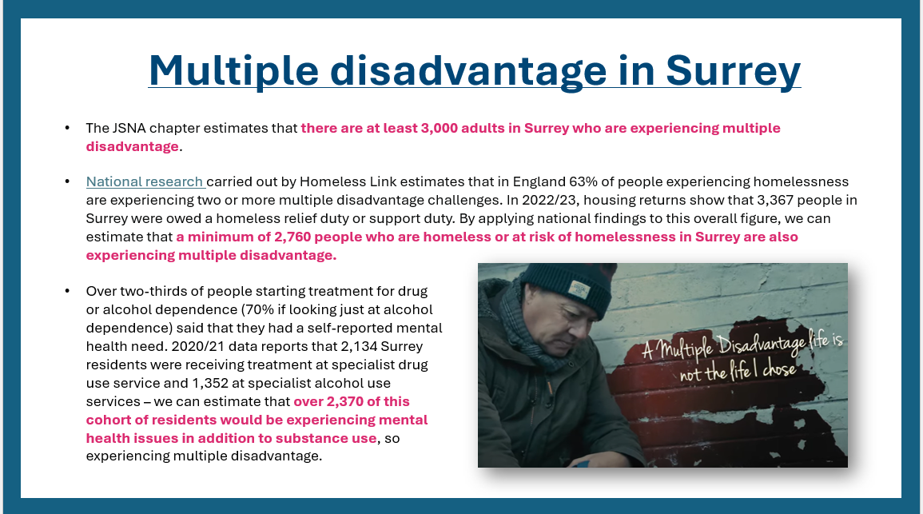
Notes:
Looking specifically at multiple disadvantage in Surrey, the following findings have been estimated from the secondary data analysis.
So firstly, the JSNA chapter estimates that there are at least 3,000 adults in Surrey who are experiencing multiple disadvantage.
Looking specifically at risk of homelessness, National research carried out by Homeless Link estimates that in England 63% of people experiencing homelessness are experiencing two or more multiple disadvantage challenges. Locally then, inn 2022/23, housing returns show that just over 3,300 people in Surrey were owed a homeless relief duty or support duty. By applying national research findings to this overall figure, we can estimate that a minimum of 2,760 people who are homeless or at risk of homelessness in Surrey are also experiencing multiple disadvantage.
Looking at substance use and mental health, over two-thirds of people starting treatment for drug or alcohol dependence in Surrey said that they had a self-reported mental health need. 2020/21 data reports that just over 2,100 Surrey residents were receiving treatment at specialist drug use service and just over 1,300 at specialist alcohol use services – we can therefore estimate that over 2,370 of this cohort of residents would be experiencing mental health issues in addition to substance use, so experiencing multiple disadvantage.

Slide 6

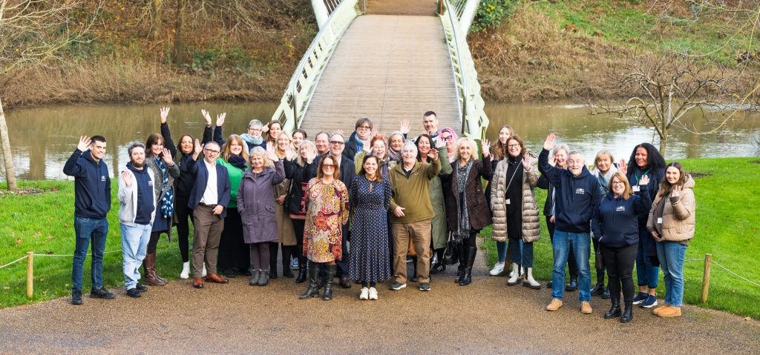
Bridge the Gap
Surrey’s prevention service supporting residents experiencing Multiple Disadvantage

Slide 7

Bridge the Gap Delivery Partners
Catalyst
Guildford Action
The Hope Hub
Oakleaf
Richmond Fellowship
Rentstart
St Peters
Your Sanctuary
North Surrey Domestic Abuse Service
South West Surrey Domestic Abuse Outreach Service
East Surrey Domestic Abuse Services
Surrey Domestic Abuse Partnership

Slide 8


Bridge the Gap Psychological Support Offer
Bridge the Gap clients receive up to 8 hours of bespoke support per week. The support includes, but is not limited to:

Slide 9



Bridge the Gap Approach
Bridge the Gap considers the underlying trauma that someone has experienced in the past and the support provided nurture's a person’s ability to shape and change their own lives.
Bridge the Gap focuses upon a persons’ strengths rather than their issues and complexities. Taking a trauma informed strength-based approach, the service sees beyond a client’s presentation and supports them towards their own personal goals. The majority of BTG clients with substance use issues are also living with mental health challenges and chronic long term health conditions. Clients do not have to be abstinent from substances to receive support.
Workers take a personalised approach, to spend time building relationships before any traditional ‘outcomes’ are achieved. Workers keep small caseloads and shape relationships built on trust and understanding that complex multiple disadvantage takes time to address, BTG continues to support people over time to make positive life changes whilst providing advocacy for their clients and challenging operational and strategic obstacles that present when seeking pertinent support for their clients. When the client is ready the BTG workers will help to ‘pull in’ specialist services at the request and pace of their client.

Slide 10
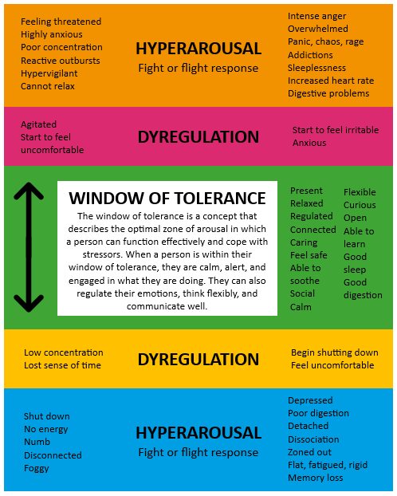
Relational Outreach
Bridge the Gap provides a trauma-informed relational outreach approach to people facing severe and multiple disadvantage. Evidence highlights the degree of childhood, prolonged and on-going trauma which people facing multiple disadvantage experience which have a compound effect on all aspects of their functioning, mental and physical health. Most are referred for support when they are presenting with behaviours and characteristics indicative of being ‘stuck’ in survival mode (Lankelly Chase, 2015).
“Window of tolerance”
Whilst in survival mode, the brain, body and nervous system are constantly within fight, flight or threat mode, and capacity for rational thinking, planning, managing day to day life and regulating oneself are predominantly switched off. The person is endlessly outside of their “window of tolerance” (The Developing Mind. D. Siegal, 1999) and left coping only with behaviours and activities which have become their means of obtaining a feeling of safety.
Notes:
Clinical oversight for the program - evidence based that underpins the work we do

Slide 11
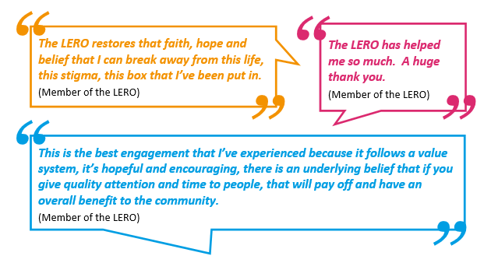
Lived Experience Recovery Organisaiton (LERO)
The LERO was set up in early 2023, with the group meeting on average 2-3 times per month through a combination of online and in-person meetings.
Lived experience and learned experience are both needed in an effective system of care and both these experiences should be valued equally. People with lived and living experience multiple disadvantage should be placed at the centre of decision-making processes and involved in the design, delivery, co-production, and evaluation of treatment and recovery support services. This means that commissioners and service providers must make sure that they meaningfully involve a wide range of people with lived and living experience in:
Strategic local and operational decisions
Needs assessments
Commissioning
Service design
Service delivery
Service review and evaluation

Slide 12

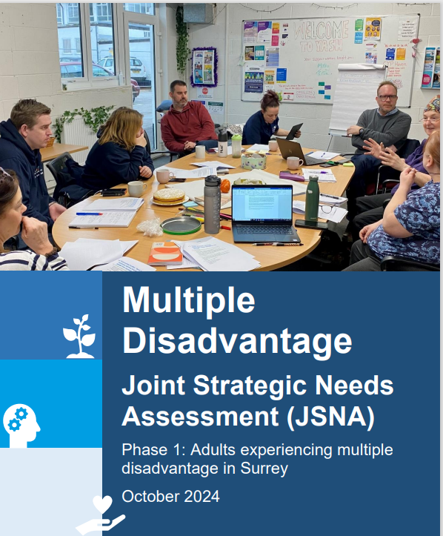
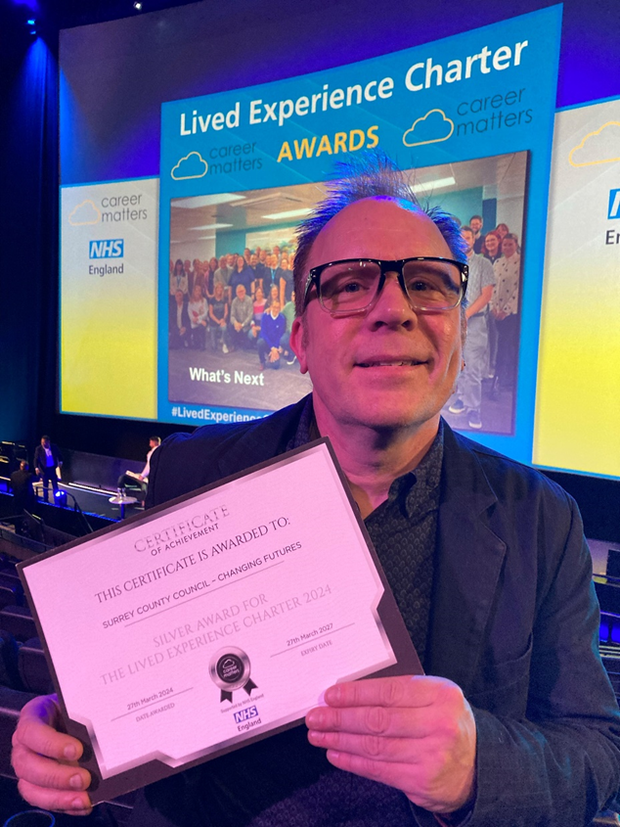
Co-produced JSNA completed and published
142 people in total have been supported by Bridge the Gap
Staff retention is high
Staff sickness is negligible, and morale is good
Rolling comprehensive staff development programme in place
Local and National Evaluation on-going
Lived Experience Recovery organisation (LERO)
Is in the process of being formalised

Slide 13

Myth busting
What doesn’t work!
What does work!
Having only one person or a very small sample representing lived experience.
Support is minimal.
Historic evidence.
Workload and responsibility overwhelming.
Having a group of experts that have access to their own recovery groups and access to a supportive lived experience group.
XX
Notes:
JAMIE

Slide 14
LERO Network
Co-production groups
National expert Citizens Group (NECG)
National lived experience Community of Practice
SMART groups
National Making Every Adult Matter (MEAM) groups
Changing Futures Surrey – Lived Experience Recovery Organisation
National Changing Futures events
Peer research networks
12 step groups
Mental health support groups
Local VCSE organisations
Homelessness forums
Notes:
JAMIE
Co production with governmental depts including OHID, MHCLG and MOJ

Slide 15

SYSTEM RECOVERY - how do we support systems to recover that mirror the values and principles practised by those in recovery?
Openness
Transparency
Honesty
Humility
Notes:
JAMIE

Slide 16
Bridge the Gap Clients
Based on data from 121 Bridge the Gap clients support from May 2023-24, clients reported a combination of experiences of multiple disadvantage:
113 clients reported experiencing a mental health need
96 clients reported experiencing a substance use disorder
73 clients reported experiencing homelessness
49 clients reported experiencing contact with the criminal justice system
33 clients reported experiencing domestic abuse

Slide 17
National Evaluations
Next independent evaluation – Autumn 2024
Evaluation of the Changing Futures Programme - Baseline report (publishing.service.gov.uk)
Mental ill health is the most prevalent form of disadvantage experienced by programme participants
There is a high degree of overlap between mental ill health and drug and alcohol problems – almost 7 out of 10 participants have experience of both
A third of participants are neurodivergent, including having learning disabilities, ADHD and acquired brain injury
Local Evaluation ( Externally Commissioned)
Seetec
Impact

Slide 18
Who is seeking support?
Reflections on themes from referrals:
Extremely high number of people with neurodivergence facing multiple disadvantage, (poor fit with existing system, resulting in exacerbated trauma and MD)
High number of people with co-occurring substance use and mental health challenges; 90% of our current cohort have a substance use issue, including ‘change resistant’ dependent alcohol users
Multiple labels: e.g. one person had 7 (including ASD, ADHD, EUPD,PTSD) and is also a HIU at A&E– so many labels and passed from service to service (different approach and less stigmatising and pathologising way of understanding the person and their needs is required?)
High frequency of label of EUPD, especially for women many of whom also have ADHD, are autistic, and/or have experienced DA, and who’s presentation and personal story of what’s happened to them is indicative of considerable relational trauma – often described as “attention seeking and manipulative” (less stigmatising, pathologising, more individual, gender sensitive understanding and language needed?)
Significant number with Brain/Head Injuries including strokes/Korsokoffs
Referrals for several people who are transgender and victims of modern slavery
High demand/referrals for service, but majority are for people who cannot ‘fit’ into what wider system can currently offer and who have experienced this as additional trauma, usually resulting in more cost to system as they bounce from service to service incl. blue lights and A&E

Slide 19
Direct referrals from HIU of A&E
Royal Surrey
  5 referrals open
Ashford & St Peter’s
  4 referrals open but 1 to close (see below)
  – can take 2 more
East Surrey
  1 referral open but currently in hospital
  – can take 4 more- NOW REFERRED!
  Next Steps: Extended Hours Support
Total BTG clients to date – 121​
Current clients – 69​
Paused clients – 8 ​
Closed clients- 44​
Experience of MD | Number | Percentage
Domestic abuse | 33 | 27
Homelessness | 73 | 60
Mental health | 113 | 93
Substance use | 96 | 79
Offending | 50 | 41
TOTAL | 121 | 100

Slide 20
Governance and Reporting
Twice in three years Independent Baseline Data - System operations Mapping ( Appendices) Independent Commissioned National and Local Programme Evaluations 2nd interim Report Evaluation of the Changing Futures programme - interim report (tnlcommunityfund.org.uk) | Once a year National and Local Programme Annual report to MHGLG and National Lottery and cross government programme board and ministers Contribute to Annual Conferences - Changing Futures/ MEAM | Once a quarter MHCLG /National Lottery Quarterly written report and scrutiny meeting for onward reporting to Cross Government Programme Board and ministers Health and Wellbeing Board/ICB update to board National Delta Returns (Bridge the Gap Outreach Workers and Clients) Local ECINS Returns (Bridge the Gap Outreach Workers and Clients) VCSE Leadership Team / Trustees Formal Contract Management Steering Group
Once a Month Changing Futures update report to MAG Professional Development for Outreach Specialists, Supervisors and VCSEs monthly | Monthly and ad hoc Clinical Supervision and Reflective practise for Outreach Specialists Extra monthly consultation slots for psychological formulations to be completed with reasonable adjustments needed | Examples of recent national invitations Government Cross-Party Forum Joint Combating Drugs Unit MHCLG Rough Sleepers Initiative team Pathways – National Inclusion health / Health Inequalities National Civil Service Conference National Citizens Group – LERO
Notes:
Governance workshop 12th Feb 1 Recommendation has suggested a refresh in the governance of MD

Slide 21

ROI 4:1 Repeat costs avoided across Surrey system - estimated net £4.7m for approx. 100 clients in 2023/2024.
Evaluation of the Changing Futures programme - interim report (publishing.service.gov.uk) confirming positive impact of national programme, Next national evaluation published October 2024
Adult Social Care:
63% of Bridge the Gap Clients are being supported to prevent or delay the requirement for statutory services including social care. 37% of current clients are open to Adult Social Care and due to the nature of their multiple/complex needs the clients are evidencing to engage better with the relational support offered by the Bridge the Gap prevention service than to the statutory social care offer. Some clients require both Bridge the Gap and social care.
System-wide saving estimate £4.7M
High Intensity Units at A&E
Fifteen (15) referrals are received on a pilot from High Intensity Units (HIU) of the three hospital A&E departments is demonstrating cost savings of approx.
£180K / client / annum (based on £20k cost rather than £200k) which cumulatively equates to net £2.7m cost avoided across 15 people supported
An additional 40 client’s with history of frequent attenders at A&E
Notes:
Return on investment

Slide 22
Nottingham’s recent analysis of MD prevalence amongst people interacting with local mental health services. This showed that people experiencing MD accounted for:
20% of all mental health contacts in the prior 12 months
30% of all urgent and emergency mental health access
40% of all inpatient admissions
Over 50% of readmissions to inpatient care

Slide 23
Case Study
P was rough sleeping and alcohol dependent (114+ units pw) also had a broken ankle
Had arrived in England via France some years previous as a refugee from Rwanda. History of significant traumas commencing in Rwanda
Problems with communication and some criminality
Due to chaotic lifestyle on the streets had no documentation of identity
Referrals were made to iAccess and ASC
Was due in court but BTG worker highlighted his communication needs and pursued support for this
An intermediary completed an assessment highlighting underlying cognitive and language difficulties and made a number of recommendations
Case was dropped NFA
Now housed in Balham – with Forward Trust for people with complex support needs
Nearer to his sister who has expressed gratitude for this as she can now see and support him
Has a social worker and his support needs are well understood
Physical health also now attended to
Took time but BTG worker organised a citizen card for him, resulting in offer of secure housing
Secured temporary accommodation
Maintained a significant period of stability and engaged in his tenancy support as well as BTG
ASC assessment, during which he commented that the BTG support was the “best support he has ever received!”
Ceased to need iAccess as drinking had significantly reduced once in temporary supported accommodation

Slide 24
Building a trusting, safe relationship, providing containment, epistemic trust, safety and boundaries: comments from outreach workers
Epistemic Trust is developing which is enabling more effective safety planning. She is able to listen and take on board advice and support of others and beginning to understand healthy relationships
Working within a Trauma Informed model allows boundaries to be maintained in a caring and flexible way. Our relationship has had a therapeutic effect as it is based on honesty and trust.
Established a trusting relationship…lot of ‘hand holding’ by spending time with him, no pressure to talk about anything, but focused on getting him into a safe environment, supporting appointments. Lot of sitting with, chatting about non-problem things. Lots of reassurance. Being consistent person - slow pace which worked for him.
During our work together it is felt that B’s self-awareness had begun to develop due to him having and being allowed to have a growing understanding of his own thoughts, feelings, values, and actions.

Slide 25
When supporting to access other services
Progress and empowerment
Bridging R into different services, advocating for him when this happened and the reasonable adjustments they would need to put in place – understanding and being able to describe his needs cognitively, emotionally, communication needs, ….because R struggles to verbalise things I didn’t giving up on asking
There is a noticeable shift in her own sense of self. She is now confident without taking substances, I was impressed with how she conducted herself in a recent meeting, she was able to speak articulately and ask for what she needed.
Problem solving for the system and advocating for them to persevere, not to discharge, as there is a tendency for services to assume intentional ‘non-engagement’ when her behaviour may actually signal a worsening in her mental health.
When I met K she was distrustful and aggressive, this ensured that she never got close to anyone.. She was afraid I would reject her…. I was consistent in my non-judgmental approach, role modelling how a relationship can ebb and flow….Over time I noticed a change in K where she could remain calm whilst relaying stories. I commented on this, she laughed, surprised and agree that she felt ‘different’.

Slide 26
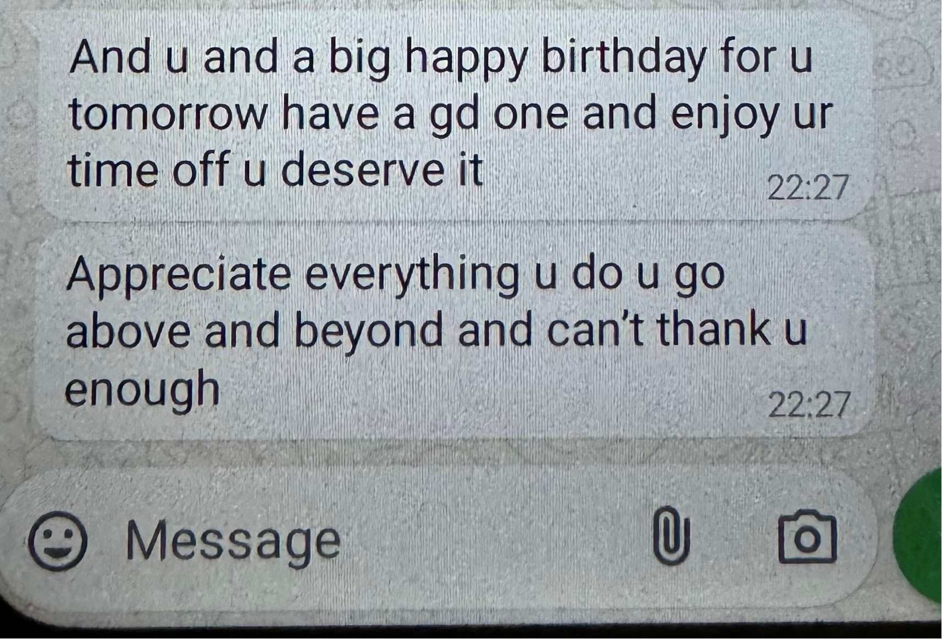
Feedback from people being supported and a carer
From a mother and identified carer of someone supported by BTG:
“This is the first time I have had that, “a break”. But only since BTG took over the support and guidance of my son’s wellbeing… I have seen people managed on short term basis only to come to the end of their allotted time with a service and return to the way they were before. This is not about handholding but guidance and assisting people to manage on their own which takes time…The changes in my son are immeasurable. (and he was extremely challenging) I can relax knowing he is under an exceptional service”.
From someone with very complex MH neurodivergent, forensic and Substance use needs, being supported by BTG
From a HIU at RSH
“I have NEVER had so much care, empathy, compassion and understanding from a professional in my life. You make me feel like I’m worth something”

Slide 27

For more information please do contact us:
Collette Le Van Gilroy
SRO Changing Futures/ Bridge the Gap Project
Collette.LevanGilroy@surreycc.gov.uk
Lisa Byrne
Changing Futures Programme Manager
Lisa.Byrne1@surreycc.gov.uk
Jamie Poole
Lived Experience Project Manager (Co-Chair of Bridge the Gap Referrals Panel)
James.Poole@Surreycc.Gov.UK
Jo Jennison
Consultant Clinical Psychologist
Jo.Jennison@SABP.NHS.UK
Thank you for listening

