Slide 1

The Inherent Jurisdiction of the High Court in England and Wales
SURREY SAFEGUARDING ADULTS BOARD
APRIL 2025
Steven Davies
Notes:
If the State intervenes in an adult’s life for care, support and treatment, without consent, it is likely that the intervention would breach that individual’s human rights (Human Rights Act, Articles 5 and 8, and potentially 3). However, there are circumstances where State intervention may be necessary to protect the individual who is at risk of harm, and as such, there are legal frameworks in place intended to enable State intervention MCA and MHA but one you may not have heard of is the Inherent Jurisdiction of the High Court. If you have heard of it, please rate your knowledge and understanding of the IJ in the following poll. This will help to guide me with the content and pace of this webinar.

Slide 2
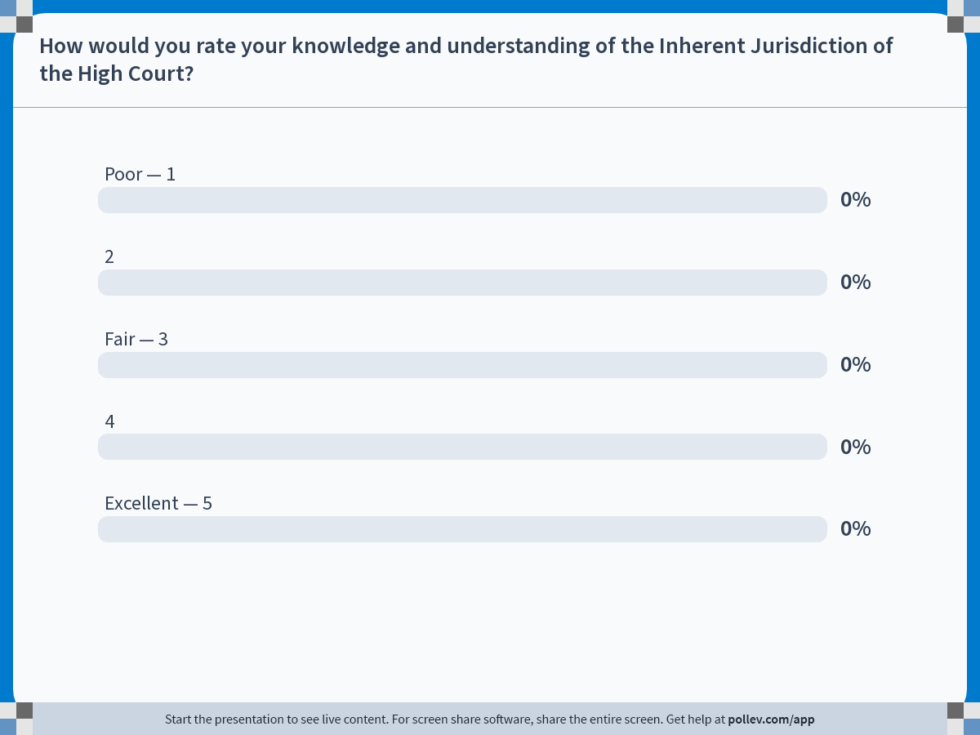
Notes:
Poll Title: Do not modify the notes in this section to avoid tampering with the Poll Everywhere activity. More info at polleverywhere.com/support How would you rate your knowledge and understanding of the Inherent Jurisdiction of the High Court? https://www.polleverywhere.com/multiple_choice_polls/gVAIldaIjjNLtqya0WVlE?state=opened&flow=Default&onscreen=persist

Slide 3
Inherent Jurisdiction (IJ)
What is it …?
“…the ability of the High Court to make declarations and orders to protect adults who do not fall within the scope of the Mental Capacity Act 2005 but who are in some way vulnerable … whose ability to decide is compromised by the actions or inactions of other people.”(Ruck Keene et al, 2024)
A developing jurisdiction complementary to statutory provisions of the Mental Health Act (MHA)1983 and Mental Capacity Act(MCA) 2005 involving vulnerable and or/incapacitated adults.
Used in decisions involving serious medical treatment, welfare, deprivation of liberty and safeguarding.
Notes:
Webinar in 2 parts – 1. nature of the IJ and 2. Its links with legal literacy in SARs
Many decisions previously subject to IJ are now taken by the Court of Protection under the MCA for those unable to make decisions as a result of incapacity relating to impairment, disturbance in functioning of mind or brain
Note use of language ‘adults who are in some way vulnerable …’ not adults at risk as per Care Act 2014
Developed to protect a wider category of VAs whose decision-making autonomy is impaired but is recognised as having capacity under MCA(Kong & Ruck Keene, 2018)
Still existed where other legislation leaves gaps. Eg MCA 2005 s 2-3
Scope = Applies to children and British nationals overseas

Slide 4
Inherent jurisdiction
When can it be used …?
A person is unable to make a decision, and they are at risk in some way from the actions or inactions of another or themselves.
When the capacity assessment takes place, a key question should be “what is the real or material reason that the adult is unable to make the decision?”
If it is the adverse influence of another it may be appropriate to seek to invoke the inherent jurisdiction.
If the reality is that the person lacks capacity to make the relevant decision, then it is inappropriate to invoke the Inherent Jurisdiction.
Notes:
Is it as a result of an impairment, disturbance in the functioning of mind or brain’ or because of an adverse influence? This will determine whether they are within scope of MCA or not. Mention similarities to CCB
Can they grasp whether the other person has interests contrary to their own? If they cannot, is this is due to a mental impairment? If the answer is that they CAN grasp this then MCA unlikely to apply. If not, then ‘best interests’ approach to help make the decision.
Discuss ‘unwise decisions’ ‘a person not to be treated as unable to make a decision merely because he makes an unwise/risky decision…’ RE FD as an example but discuss later
Uses of the IJ have ranged from marriage, contraception, sterilisation, controlling and coercive behaviour, dysfunctional family relationships, ASE,CSE

Slide 5
Re T [1992] 3 WLR782
Pregnant daughter of Jehovah’s witness and blood transfusion
Spoke to mother in hospital and declined blood transfusion
‘in all the circumstances’ she lacked capacity to take the decision regarding a blood transfusion.
Mother had vitiated her decision
Notes:
Jehovah witness case – 34 weeks pregnant in car crash her mother was a JW but daughter was not - before losing consciousness in hospital spent time with mother following which she told doctors she did not wish a blood transfusion. CA found that in all the circumstances she lacked the capacity to make a decision re blood transfusion ie even if she had been conscious – due to the ‘adverse influence’ of her mother OVERBEARING INFLUENCE

Slide 6
Re SA(Vulnerable Adult) with capacity: Marriage [2005] EWHC 2942 Fam
“…can be exercised in relation to a vulnerable adult who even if not capacitated by mental disorder or illness is or reasonably believed to be either
Under restraint or
Subject to coercion or undue influence or
For some other reason deprived of the capacity to make the relevant decision, or disabled from making a free choice, or incapacitated or disabled from giving or expressing a real and genuine consent.”
Notes:
Re SA – young female user of BSL & mild LD/capacity to marry/arranged marriage on condition of returning to UK/welfare checks in Pakistan/legal undertakings by family to allow her home/POA attached
Later endorsed in LA v DL & oths

Slide 7
A Local Authority v DL[2011]EWHC 1022 Fam
All legal options explored and rejected
‘Necessary’ and ‘proportionate’
Investigation of ‘less intrusive measures’
Intervention was ‘facilitative rather than dictatorial’
“Re-establish … the individual’s autonomy of decision making in manner which enhances rather than breaches their ECHR Article 8 rights.”
Notes:
The MCA, ASBO, ASB injunction – had been unsuccessful or were not applicable in the circumstances
Adult son threatening elderly parents, preventing contact with friends & family, coercion to transfer family home, move into care home, orders to care staff, refusing access to HSC professionals, interfering with care and support, aggressive to support staff
Parents both had capacity to decide to have contact with son and where to live and wished to preserve their relationship with son but to their detriment. “The influence of close relatives may be subtle, insidious, pervasive and powerful.” Following an appeal which was rejected, the court confirmed that the ‘great safety net’ still existed.

Slide 8
Re FD [2017]
Injunction arising from Wardship proceedings, protecting a vulnerable child from GH and AD
On 18th birthday the Court of Protection ordered new mental capacity assessment
Psychiatrist found that FD did have capacity to make certain decisions but was nevertheless extremely vulnerable
Court agreed to continue with injunctions against both men
No power of arrest attached.
Notes:
Wardship proceedings – FD was a child with LD exploited by male partner GH and AD(father) forced to take drugs suffered violence by cutting and both stole money from her. FD was scared of both men.
Injunctions in place against GH & AD until 18th birthday – CoP need to decide whether to continue with injunction – fresh capacity assessment for FD and Psych concluded that she did have capacity to conduct proceedings, where to live, and have a relationship but was nevertheless vulnerable and susceptible to malign influences by GH and AD – court accepted it had power to continue the injunctions against GH AD – but not to attach a power of arrest and enforcement would need to rely of committal for contempt of court. Very similar to circumstances of MOLLY SAR Teeswide
(Also, Birmingham CC v Riaz and others 2014 (CSE case involving a 17 year old female) , but note criticism of the use of high court powers by the judge due to the availability of similar injunctions through other courts and whether he had fully considered the ECHR)

Slide 9
(Truly)Exceptional use of the Inherent Jurisdiction
Making orders against the person themselves where there is a third party presence or
Where the sole is risk if from the actions of the person themselves(no third party presence)
Where a person lacks capacity but MCA cannot be used for some reason
Notes:
Adult must be able to understand the nature and purpose of the injunction and appreciate its effects
Examples – prevent contact between A and B but using it against the person themselves without third party involvement is very close to misuse and breach of ECHR rights
Must not improperly impose jurisdiction to reverse outcome of a statutory scheme
Marriage to VA with LD not recognised in UK or overseas – (MCA only has jurisdiction to make declaration in UK) XCC v AA & Anor EWHC 2012
GSST SLAM v R person likely to lose capacity in labour

Slide 10
IJ,MCA 2005 and MHA 1983
Both statutory schemes aim to protect vulnerable individuals, but they differ in their focus and application.
The MCA 2005 deals with decision-making for those who lack capacity, whereas the MHA 1983 addresses the treatment of mental health disorders
Additionally, MCA 2005 emphasizes best interests and participation, while MHA 1983 provides guidelines for compulsory admission and treatment
Neither addresses situations where ‘oppressive dynamics’ are the sole or material reason for incapacity or a liability to be detained.
Notes:
Similarities and distinctions - IJ only available where proceedings DO NOT fall within the MCA or the MHA is not available
MCA does not address situations where there are oppressive dynamics such as undue influence, coercion, intimidation and these factors are the sole/predominant reason for incapacity(external malign influence)

Slide 11
IJ, MCA 2005 and MHA 1983
In an NHS Trust v Doctor A[2013], a patient needed to be deprived of his liberty and was resisting medical treatment.
The treatment was not relevant to a mental disorder or impairment so the MHA could not be used for forced-feeding(the treatment for physical issues not related to mental health)
Nor could the MCA be used due to S16A*
This created a gap in the law.
Under the IJ the court was able to make orders for nutrition and hydration as the other relevant legislation was preclusive.
Notes:
GAPS
*S16A ‘If a person is ineligible to be deprived of his liberty by this Act (Sch 1A) the court may not include in a welfare order, provision which authorises the person to be deprived of his liberty’
When the liberty protection safeguards come into force s 16A will be repealed
Cases illustrating overlap and preclusivity in some cases - Similarly in a recent case was Surrey Police v PC & Others 2024 where a person detained by the police and liable to be sectioned under the MHA meant that the MCA could not apply (Sch1A). To ensure that PC’s detention lawful until the section took effect the IJ was only remedy available in the circumstances.

Slide 12
Inherent Jurisdiction
However, the IJ has been criticised …
Referred to as ‘amorphous’ and ‘illusive’
Breach of ECHR rights
Not a ‘lawless void permitting judges to do whatever we consider to be right’ (Redbridge LBC v A [2015])
Can be a ‘protective imperative’ (Mazhar v Birmingham[2020[)
Notes:
Criticisms – draconian, undermines ECHR, Care Act principles, ‘protective imperative’
Courts have expressed doubt as to whether it is ever lawful to use IJ to deprive a person with capacity of their liberty – unfortunately not settled by Mazhar v Birmingham
Would need to apply the ‘acid test’ in Cheshire West continuous supervision/control/unable to leave – preventing a return home could constitute confinement (Redcar & Cleveland BC v PR & Othrs 2019)
Mazhar case discussed whether the IJ can authorise deprivation of liberty of a capacitated non mentally disorder person for urgent medical treatment – out of hours ‘protective imperative’ without full information
Judgment is the basis for the Checklist on next slides

Slide 13
Inherent Jurisdiction
Checklist before making an application:
Before making an application consider what other legislative mechanisms exist and whether they have been tried.
Is the interference with a person’s rights necessary & proportionate?
Orders directed against the individual?
Is presiding judge authorised under s9(1) Senior Courts Act 1981 to hear the application?
Notes:
CCB, non molestation orders, DAPN, DAPO, DVPO, SPO or restraining order? IJ cannot be used to reverse a statutory scheme if court disagrees with the outcome
DOL in emergency situations – orders made should be for as short a period as possible - Surrey Police v PC & Others2024, Redcar & Cleveland BC v PR & Othrs 2019
Less intrusive measures to achieve the same aim?
Orders against individual only in truly exceptional’ cases – likely to the understand purpose, receive knowledge and appreciate the effect of an injunction. E.g. smoking or self-neglect LB Croydon v CD 2019
Civil Procedure Rules 1998 apply for applications and costs

Slide 14
Without notice(ex parte) applications
Only ex parte in exceptional and urgent circumstances.
Complete information required to include:
Reasons
Full and frank disclosure
Full record of court hearing
Why the IJ is applicable in the circumstances
Facts to be recorded in the Order along with Recital
Order should include the basis on which the court has reason to believe it is empowered to make such an order
Return to court ASAP
Notes:
Each public body joined jn proceedings – application supported by evidence – ONE STATEMENT
Recital = details of the case not included as part of the Order
Mazhar v Birmingham Community Healthcare Foundation NHS Trust & Ors [2020] EWCA Civ 1377 see guidance on ex parte hearings before the CoP (39 Essex Chambers) also guidance from OS in Surrey Police v PC

Slide 15
IJ, SARs and legal literacy
Safeguarding Adult Review s44 Care Act
National analysis of SARs(2016 -2023)
40% SARs highlighted an absence of legal literacy and non-consideration of Inherent Jurisdiction (Bedford et al, 2025)
Clusters of cases identified in the research
Familial and domestic abuse
Community exploitation
Self-neglect
Notes:
S44 SAR when there is a reasonable cause for concern about how partner agencies worked together to safeguard an adult with care and support needs and adult has died or suffered abuse/neglect
National analyses of SARs – covering issues such as financial abuse, ASE, cuckooing, care refusal, alcohol misuse, self neglect, conflict with professionals, amputation refusal, self-discharge, smoking, personality disorder
Central focus on LEGAL LITERACY (knowledge of the law and ability to weigh up most appropriate pathway.(Braye/Preston Shoot 2016) ONLY 16% of SARs in research mentioned IJ as part of it review – maybe it was not relevant but might also be that insufficient knowledge amongst MA group
Research focussed on IJ – 3 clusters

Slide 16
IJ, SARs and legal literacy
Familial and domestic abuse
‘family conflicts’ and ‘relationships’ not fully explored
‘coercive’ family dynamics
Effects of statutory schemes and interventions
Exclusion and homelessness (Molly SAR Teeswide, 2022)
Notes:
Could IJ have offered a remedy for malign influences impeding choice? Are there individuals against whom injunctive relief might be effective and where statutory interventions have failed?
Discuss Molly ASE – chronic case of ASE forced drug use, coercion to control behaviour leading to undue influence – IJ considered but rejected on basis that ‘court would only be able to impose safe accommodation … and this was not available locally’ Did not consider inunctions against third parties (eg as in FD) … advice not challenged with suggested alternative orders

Slide 17
IJ, SARs and legal literacy
Community based exploitation
‘cuckooing’ – exploitation where a home is taken into the control of others for illicit purposes(MacDonald et al, 2022)
‘consent’ for others to enter their homes(Adult P SAR, Southampton 2019, Carol SAR, Teeswide 2017)
‘declined’ alternative and safer accommodation(Max SAR, Bedfordshire 2022)
Notes:
Others= drug gangs, street drinkers
Consent or lack of consent due to UNDUE INFLUENCE?
Should IJ be considered where other interventions/stat schemes are unavailable or unsuccessful?

Slide 18
IJ, SARs and legal literacy
Self neglect
Are there coercive dynamics from a third party?
If so, the IJ may offer a remedy by restricting the actions of the adverse influence (David SAR Rotherham, 2021
In Harry, his ‘friends’ were unduly influencing him to pay for his care
Refusals to medical treatment for leg ulcers, DVT, sepsis where coercion was a factor(Miss T SAR IoW 2016, Honor SAR Swindon, 2017)
Notes:
IJ pathway inappropriate where no relational factors such as coercion, duress or abuse.
NHS teams should consider own legal advice for pathways and potential interventions rather than relying on ASC and local authority not just an issue of legal literacy …training, escalation policy and professional curiosity

Slide 19
A last resort?
A ‘residual power’ where other remedies are not applicable or available.
It is not necessary for all possible responses to have failed before the IJ can be considered(Bedford et al, 2025)
The key issue is whether a less intrusive measure could achieve the intended objective without unacceptable compromise (R (Lord Carlile of Berriew QC) v SSHD [2014])
Notes:
A measure is not disproportionate merely because a less intrusive option could have been chosen! Emergency cases to prevent a real and immediate risk and it would be counterproductive to test every alternative (Z and oths v UK 2001) failing to protect children from neglect(breach of Art 3)
Most likely to be considered in the chronic, complex cases where many other strategies have been tried and failed
In some cases there may even be an obligation to consider such a remedy under a local authority’s duty to comply with HRA 1998.

Slide 20
Some final thoughts …
IJ is not a panacea …
Need for policy development in light of existing case law and what IJ can and cannot offer …
Consider what remedies might be realistic and pragmatic in light of this
Notes:
Cannot attend to every complexity that arise and there are dangers in over optimism of what IJ can provide

Slide 21
Questions?

Slide 22
References
Bedford et al (2025) Rethinking the Inherent Jurisdiction of the High Court in Safeguarding Adult Reviews: Beyond Legal Literacy;JK publishing Bedford_et_al_2025_AAM.pdf
Mandelstam M (2019) Safeguarding Adults and the Law (2008)
Weereratne et al (2008) A guide to the MCA 2005 Lexis Nexis;Butterworths.
Ruck-Keene A, et al (2024) Using the Inherent Jurisdiction in Relation to Adults 39 Essex Chambers.

