Slide 1
“When you ring up the GP you have to talk to the receptionist first and they don’t know about domestic abuse and how to deal with it. When I first got help, I spoke to 10 different doctors over 16 appointments and had to tell my story each time. No one knew where to signpost me. I was told I looked nice, so people didn’t believe me.”

Slide 2
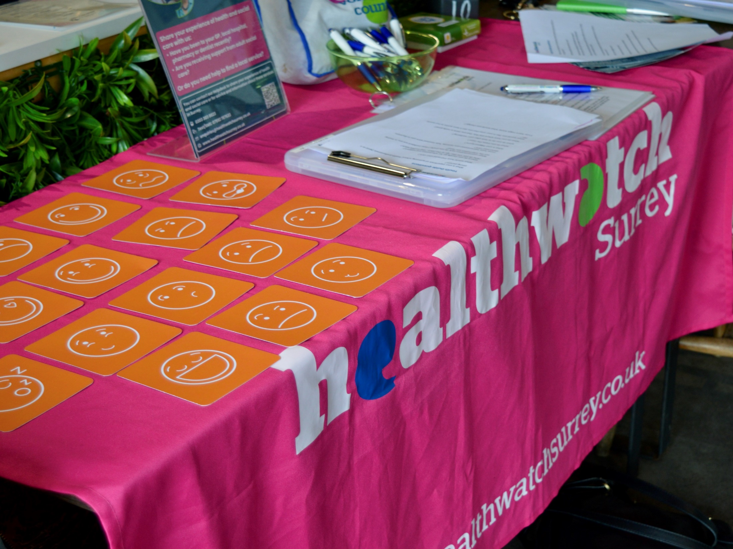

Research into access to and experience of GP practice for people experiencing domestic abuse
In Safe Hands?: Access and experience of GP practice for people experiencing domestic abuse

Slide 3
Context: defining domestic abuse
“Any incident or pattern of incidents of controlling, coercive, threatening behaviour, violence or abuse between those aged 16 or over who are or have been intimate partners or family members regardless of gender or sexuality.”
Domestic Abuse Act 2021
Notes:
What do we mean by domestic abuse? Just to remind ourselves of what we mean when we use the term domestic abuse. It encompasses more than extreme physical and sexual violence, which often bears physical signs or evidence, we are concerned with coercive and controlling behaviour such as financial/economic abuse, attempts to isolate or estrange people from their friends and loved one and we are also not just focusing on the home. We are concerned with relationships between intimate partners or family members, men or women, adults or children, gay or straight… and these can exist outside the home as well as in it.

Slide 4
Context: prevalence
Numbers of domestic abuse cases are rising nationally and within Surrey:
2.1 million people aged 16 years and over experienced domestic abuse in the year ending March 2023, equating to roughly 5 in 100 adults.
5,224 calls were made to the Surrey domestic abuse helpline in 2023, up by 24% from 2022.
People experiencing domestic abuse are recognised as a priority population within the Surrey Health and Wellbeing Strategy.
People had disclosed domestic abuse to us but not told us about their experience of support from their GP practice.
There is a lack of data on domestic abuse from within GP practices.

Slide 5



Approach
In collaboration with local partners, we sought to gauge the views of both survivors and professionals, via an online survey and a series of focus groups and interviews. In total, we spoke to 64 Surrey survivors and 8 GP practices.

Slide 6
Aims of the research
To explore whether general practice is meeting the needs of people who are experiencing domestic abuse within Surrey, and what improvements can be made to better meet these needs.
What are the barriers those experiencing domestic abuse face in disclosing that they are experiencing abuse to a GP or a member of the team within their GP practice?
What would make it easier for someone to disclose that they are experiencing domestic abuse?
Are GPs referring people experiencing domestic abuse to specialist services as much as they should be? If not, why not?
How can the experience of people experiencing domestic abuse accessing healthcare from their general practice be improved?

Slide 7
Findings: all stages of the primary care journey
Barriers to disclosing domestic abuse
(5 x institutional
2 x survivor perceptions)
Experiences following disclosure or the decision to disclose
Signposting and referrals

Slide 8

Barriers to disclosing domestic abuse
Institutional factors and processes
Lack of professional curiosity – GPs not questioning the reason behind presentations and a tendency to prescribe medication as the only solution.
Appointment booking and confidentiality – lack of confidential space and discretion from reception staff, concerns about the digital trail left by on-line booking systems and lack of timely and unhurried face-to-face appointments with a preferred GP.
Perceived lack of understanding – an underlying fear of not being believed and a perception of a lack of GP understanding of all forms of abuse.
Fear of authority – feelings of intimidation around GPs.
Perpetrator’s presence – not being able to disclose with their perpetrator physically present or inhibited by their perpetrator being registered at their GP practice or with the same GP.
Positive experience

Slide 9
Barriers to disclosing domestic abuse
Survivor perception and beliefs
Generational and cultural attitudes – beliefs around not discussing domestic matters outside the home
Recognition of domestic abuse – lack of awareness that what was being experienced was domestic abuse.
“We look for mental health issues, women’s chronic pain, pelvic pain, recurring presentations i.e. frequent attenders, drug and alcohol abuse, families with children with special needs. A big takeaway from the face-to-face training I did 18 months made me think about some of the more subtle ways in which people may be presenting.” Surrey GP
Survey respondents said barriers to disclosure are:
The appointment doesn’t allow me enough time to explain (50%)
I feel scared (41%)
I feel embarrassed (41%)
I don’t think I’ll be believed (41%)

Slide 10
Experiences following disclosure or the decision to disclose
Survivors told us that, following disclosure, they were concerned that:
They would not be believed, particularly if their abuse was non-physical, or that they were male or a parent.
They would be ‘problematised’ or labelled with a specific medical condition or problem (and then treated for that problem not supported to deal with the abuse).
Members of the GP practice team did not have the domestic abuse knowledge to support them going forward and, on occasion, provided harmful or unsafe advice.

Slide 11
Signposting and referrals
68% of respondents to our survey said that they were not signposted to specialist help from an independent domestic abuse and violence service once they had shared their domestic abuse experience with their GP.
89% of respondents said that a GP or another member of the practice team had not directly referred them to receive specialist help.
Survivors identified a lack of communication between GP practices and specialist domestic abuse services as a key issue.
We also noted there was inconsistency in terms of systems for managing referrals and follow up.

Slide 12
Signposting and referrals
SWSDA reported only 0.1% of all referrals came from GP practice in 2024.
SWSDA reported only 0.1% of all referrals came from GP practice in 2024.
“When I went to see my GP, I was recognised as a victim and my perpetrator was named. But this was all I got. I wasn’t referred to anyone else. GPs work in silos. It was the police who referred me for help, but I don’t think I had an expectation that the GP would do this. I would go to them for a sore throat or a cold but not for this.” Surrey survivor
“I always refer people, rather than signpost, but people decline as they don’t want it on their record and are worried that their perpetrator might find out. I suspect that people are signposted when they should be referred.”
Surrey GP
SWSDAS reported only 0.1% of all referrals came from GP practice in 2024.

Slide 13
Convening workshop – 14 May 2025
Aim:
To review the findings of our research looking at what people have told us about access to and experience of support from GP practice for domestic abuse.
To work collaboratively to develop pragmatic and practical solutions to improve access to support and the experience of survivors.
The workshop was attending 21 by people, including system partners, GPs and external stakeholders representing survivors including Good Company, Surrey Minority Ethic Forum and Surrey Police.

Slide 14
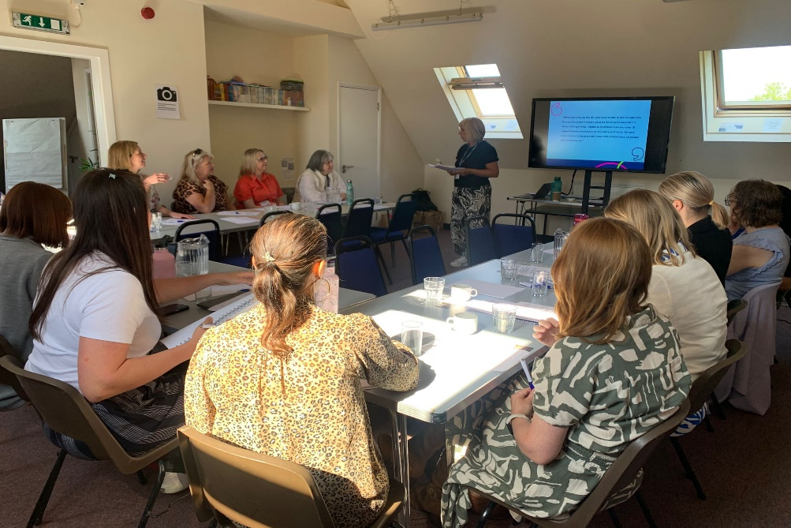
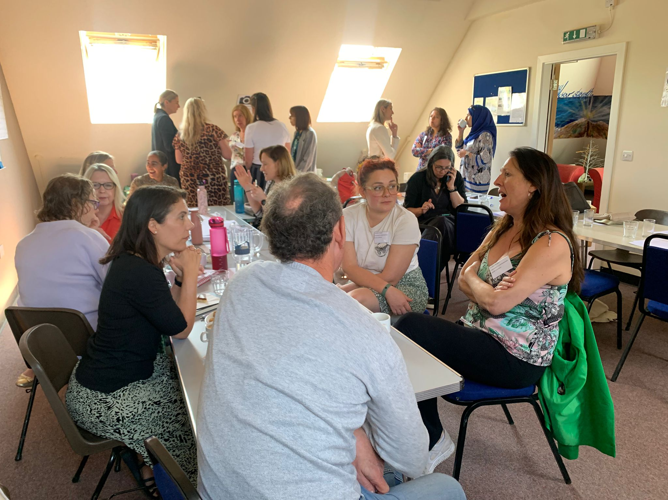
Convening workshop – 14 May 202
“There was a great willingness in the room to drive positive changes forward and good discussions around what is realistically achievable and how we can think about doing that.”
“Highly valuable and insightful.”
“[The workshop provided a]detailed assessment of various barriers and factors highlighted by the research, utilising the skill set in room to form pragmatic solutions.”

Slide 15
Suggestions from the workshop
Barriers to disclosing
Develop a “trojan horse” which enables people experiencing domestic abuse to alert a GP practice that this is their situation and for signposting information to be shared discretely
Promote domestic abuse specialists within a practice by agreeing a slogan/logo with survivors which demonstrates alliance against domestic abuse.
Experience following disclosure
Provide ongoing education and training to improve understanding of the different forms of domestic abuse, specifically coercive control, within general practice
Target front line staff in general practice to receive training in trauma informed approaches to care
Continue work on health passports for domestic abuse survivors
Share examples of best practice in individual GP practices and ensure consistency across GP practice.

Slide 16
Suggestions from the workshop
Signposting/referrals
Identify the pathway for domestic abuse survivors and scope the support available/required
Create a standardised referral form which is managed at a central point and embedded in GP practice computer systems
Develop stronger links between outreach providers/link workers and local GP practices
Create a directory of services for use within GP practices.
Principles for action
Ensure consistency across general practice in Surrey
Ensure a survivor led approach to future improvements
Maintain momentum.

Slide 17


Next steps
Publish the research and share it widely
Target key decision making forums and establish subsequent plans for action.

Slide 18
Interim Impact Report
Promotion
Shared with the lived experience lead at the Domestic Abuse Commissioner's Office who asked to share the report with NHS England’s domestic abuse and sexual violence team and with Standing Together Against Domestic Abuse (STADA) who host a policy working group on improving the response to domestic abuse within health settings
Shared via Surrey Policy to AAFDA - Advocacy After Fatal Domestic Abuse.
DA Executive and VAWG Steering Group
Surrey Safeguarding Adults Board have asked to incorporate the report in their Safeguarding Adults Week in the Autumn and for our involvement in the planning stages
Press release generated radio interviews with BBC Radio Surrey and Surrey Hills radio
Commitment to action
Commitment made on the day through evaluation form

Slide 19









How to contact us:
0303 303 0023 (local rate number)
07592 787533 (text only)
07592 787533
enquiries@healthwatchsurrey.co.uk
www.healthwatchsurrey.co.uk
Healthwatch Surrey
Healthwatch_surrey
Healthwatch Surrey
The Healthwatch Surrey service is run by
Luminus Insight CIC, known as Luminus.
We are committed to the quality of our information. Every 3 years we perform an audit so that we can be certain of this.

Slide 20
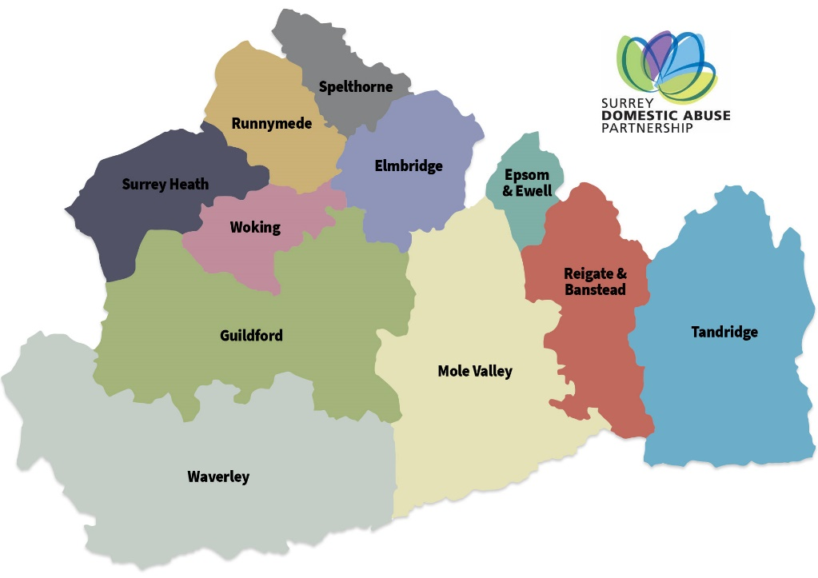
Useful Contacts
Domestic Abuse Outreach Services in Surrey
East Surrey Domestic Abuse Service (ESDAS)
Tel: 01737 771350, Hours: 9am - 4pm (Monday to Friday) Email: support@esdas.org.uk, Web: www.esdas.org.uk
Covers – Mole Valley, Reigate & Banstead, Tandridge
North Surrey Domestic Abuse Service (NSDAS)
Tel: 01932 260690, Hours: 9am - 4pm (Monday to Friday) Email: nsdas@caew.org.uk, Web: www.nsdas.org.uk
Areas Covered – Elmbridge, Epsom & Ewell, Spelthorne
South West Surrey Domestic Abuse Service (SWSDA)
Tel: 01483 898884, Hours: 9am - 4pm (Monday to Friday) Web: www.swsda.org.uk
Areas Covered – Guildford, Waverley
Your Sanctuary
Tel: 01483 898884, Hours: 9am - 4pm (Monday to Friday) Web: www.swsda.org.uk
Areas Covered – Runnymede, Surrey Heath, Woking

Slide 21
Useful Resources
Surrey Domestic Abuse Partnership – www.sdapartnership.org
Healthy Surrey - Domestic Abuse - www.healthysurrey.org.uk/domestic-abuse/professionals
Surrey Safeguarding Adults Board - Types of Abuse - Surrey Safeguarding Adults Board
Healthwatch Surrey -In Safe hands – Domestic Abuse Survivors Experience of General Practice Report - In safe hands- Domestic abuse survivors experiences of general practice - July 2025 | Healthwatch Surrey

